Slide 1
Vision for Donald Lynch Boulevard
March 18, 2024

Slide 2
Agenda
Purpose
Background
Challenges and Opportunities
Successes
DLB Overlay District
Next Steps

Slide 3
Purpose
To develop a shared vision for the future of Donald Lynch Boulevard (DLB) and the surrounding Limited Industrial area to define changes in zoning that will proactively guide the commercial corridor to be an economic engine for the city.
The purpose of this Urban Affairs meeting is to get input from the City Council before formally submitting the zoning change.

Slide 4
Background
2017 – initial discussions with Attorney Gadbois
2020 – continued with Attorney Austin
2021 – MAPC/MEDC coordinated two public meetings, included Town of Berlin Economic Development Committee.
2021 - Draft vision document issued
2023 - Final vision document issued
2023 - Submitted to Urban Affairs. Carried over to 2024 City Council.

Slide 5
Challenges and Opportunities
Malls are struggling to stay economically viable as consumer shopping habits evolve
Vacancy on DLB
Help with employee Retention/Attraction for existing and new business (with addition of new amenities/services/retail)
Feedback from businesses includes the ability to attract/retain employees is a major factor in choosing a location. If the City helps businesses attract and retain employees by making the area more attractive with amenities, then the City will be helping the overall business attraction/retention efforts.
Bring new or additional visitors to the area (that will most likely utilize new or existing businesses/restaurants)
Lack of restaurants/drive thru facility for employees and visitors

Slide 6
Successes
Aspen Aerogel
Sartorius
$5.5 million in upgrades to the DLB roadway infrastructure
New England Sports Center (~$1 million annually)

Slide 7
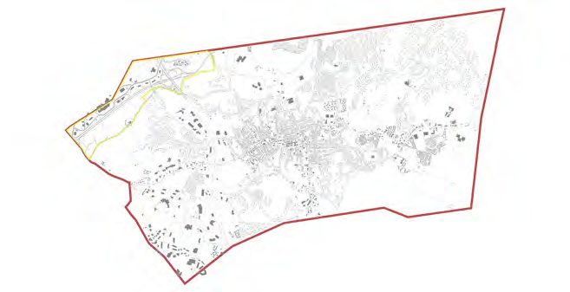
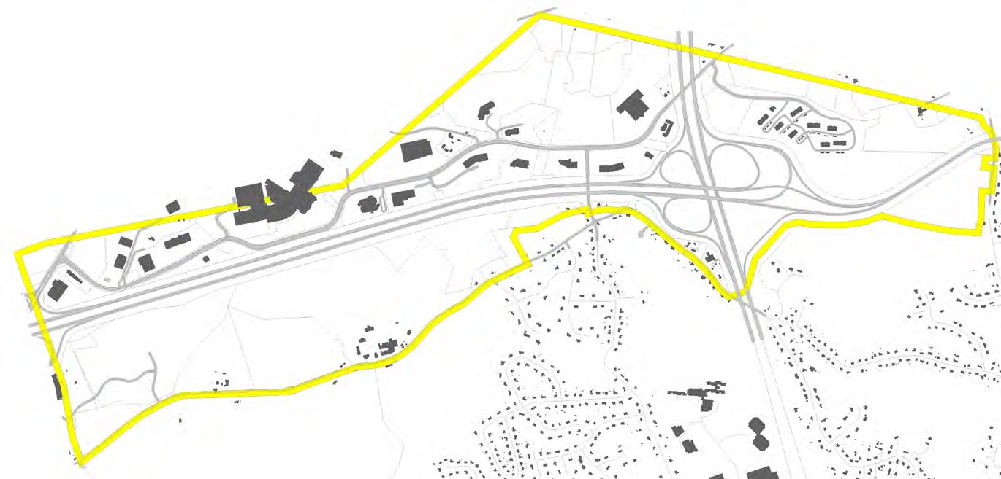
City of Marlborough Locus Map
Donald Lynch Boulevard Study Area
Marlborough Vision for Donald Lynch Boulevard
7
Final Report

Slide 8
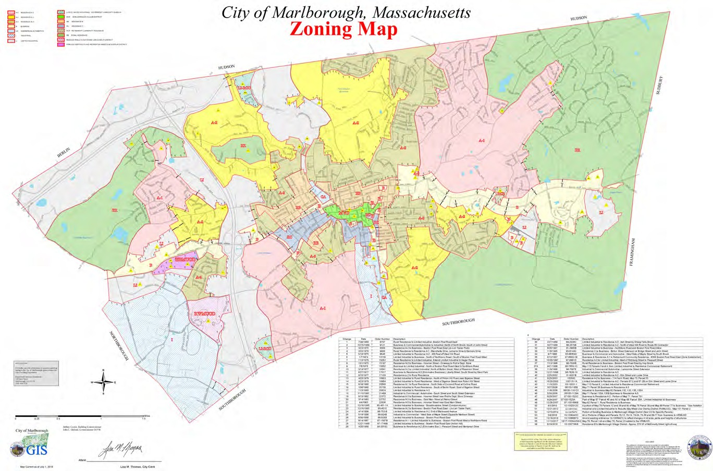
City of Marlborough Zoning Map with recommended overlay boundary (outlined in black)
Marlborough Vision for Donald Lynch Boulevard
41
Final Report

Slide 9
Zoning Use Modifications
LI is “Y” – change to “SP” in DLB
Residential accessory uses; customary home occupations; yard sales, charitable sales bazaars; soil removal; agriculture, horticulture or floriculture > 5 acres; airports and heliports; manufacturing and/or warehousing; and data storage/telecommunication facilities.
LI is “SP” – change to “N” in DLB
Outdoor storage; contractor’s yard; and landscape contractor’s yard.
LI is “SP” – change to “Y” in DLB
Restaurant, cafe

Slide 10
Zoning Use Modifications continued
LI is “N” – changed to “Y” in DLB
Medical office/clinic; public recreation and conservation.
LI is “N” – change to “SP” in DLB
Multi family dwelling; artist studio/live/work gallery space; recording studio/live/work space; convert building to office, bank, insurance use; schools for business, trade, music, dance and television/radio broadcasting (not including towers); health, sports and fitness clubs (indoor and/or outdoor) recreation and entertainment, indoor; private clubs, nonprofit; clubs; self service laundry; dental clinics; customer service establishments; mixed use development; copy shops, newspaper offices; open air markets; restaurant with drive-in or drive thru facilities; drive-thru facilities; manufacturing most items sold on site; light manufacturing using portable electric machinery; retail sales to manufacturing; and dry cleaning.

Slide 11
Dimensional, Parking, Curb Cuts
Remove restriction for height adjacent to residential and change from 52 feet tom 60 feet
Small lot development within an existing parcel – minimum frontage of 50 feet (maintain the 2 acre minimum lot)
Lower minimum parking requirements
Council approves reductions in parking requirements

Slide 12
Next Steps
Looking for Urban Affairs input
Formally submit zoning change to the City Council in April
Refer to Urban Affairs and Planning Board
City Council public hearing in May
Planning Board will conduct public hearing
Council action by August

