Slide 2
Local Roots NE, Inc.
Special Permit and Site Plan Review Adult Use- Retail Marijuana Establishment
910 Boston Post Road, Suite 100 Marlborough, Massachusetts
October 22, 2020

Slide 3
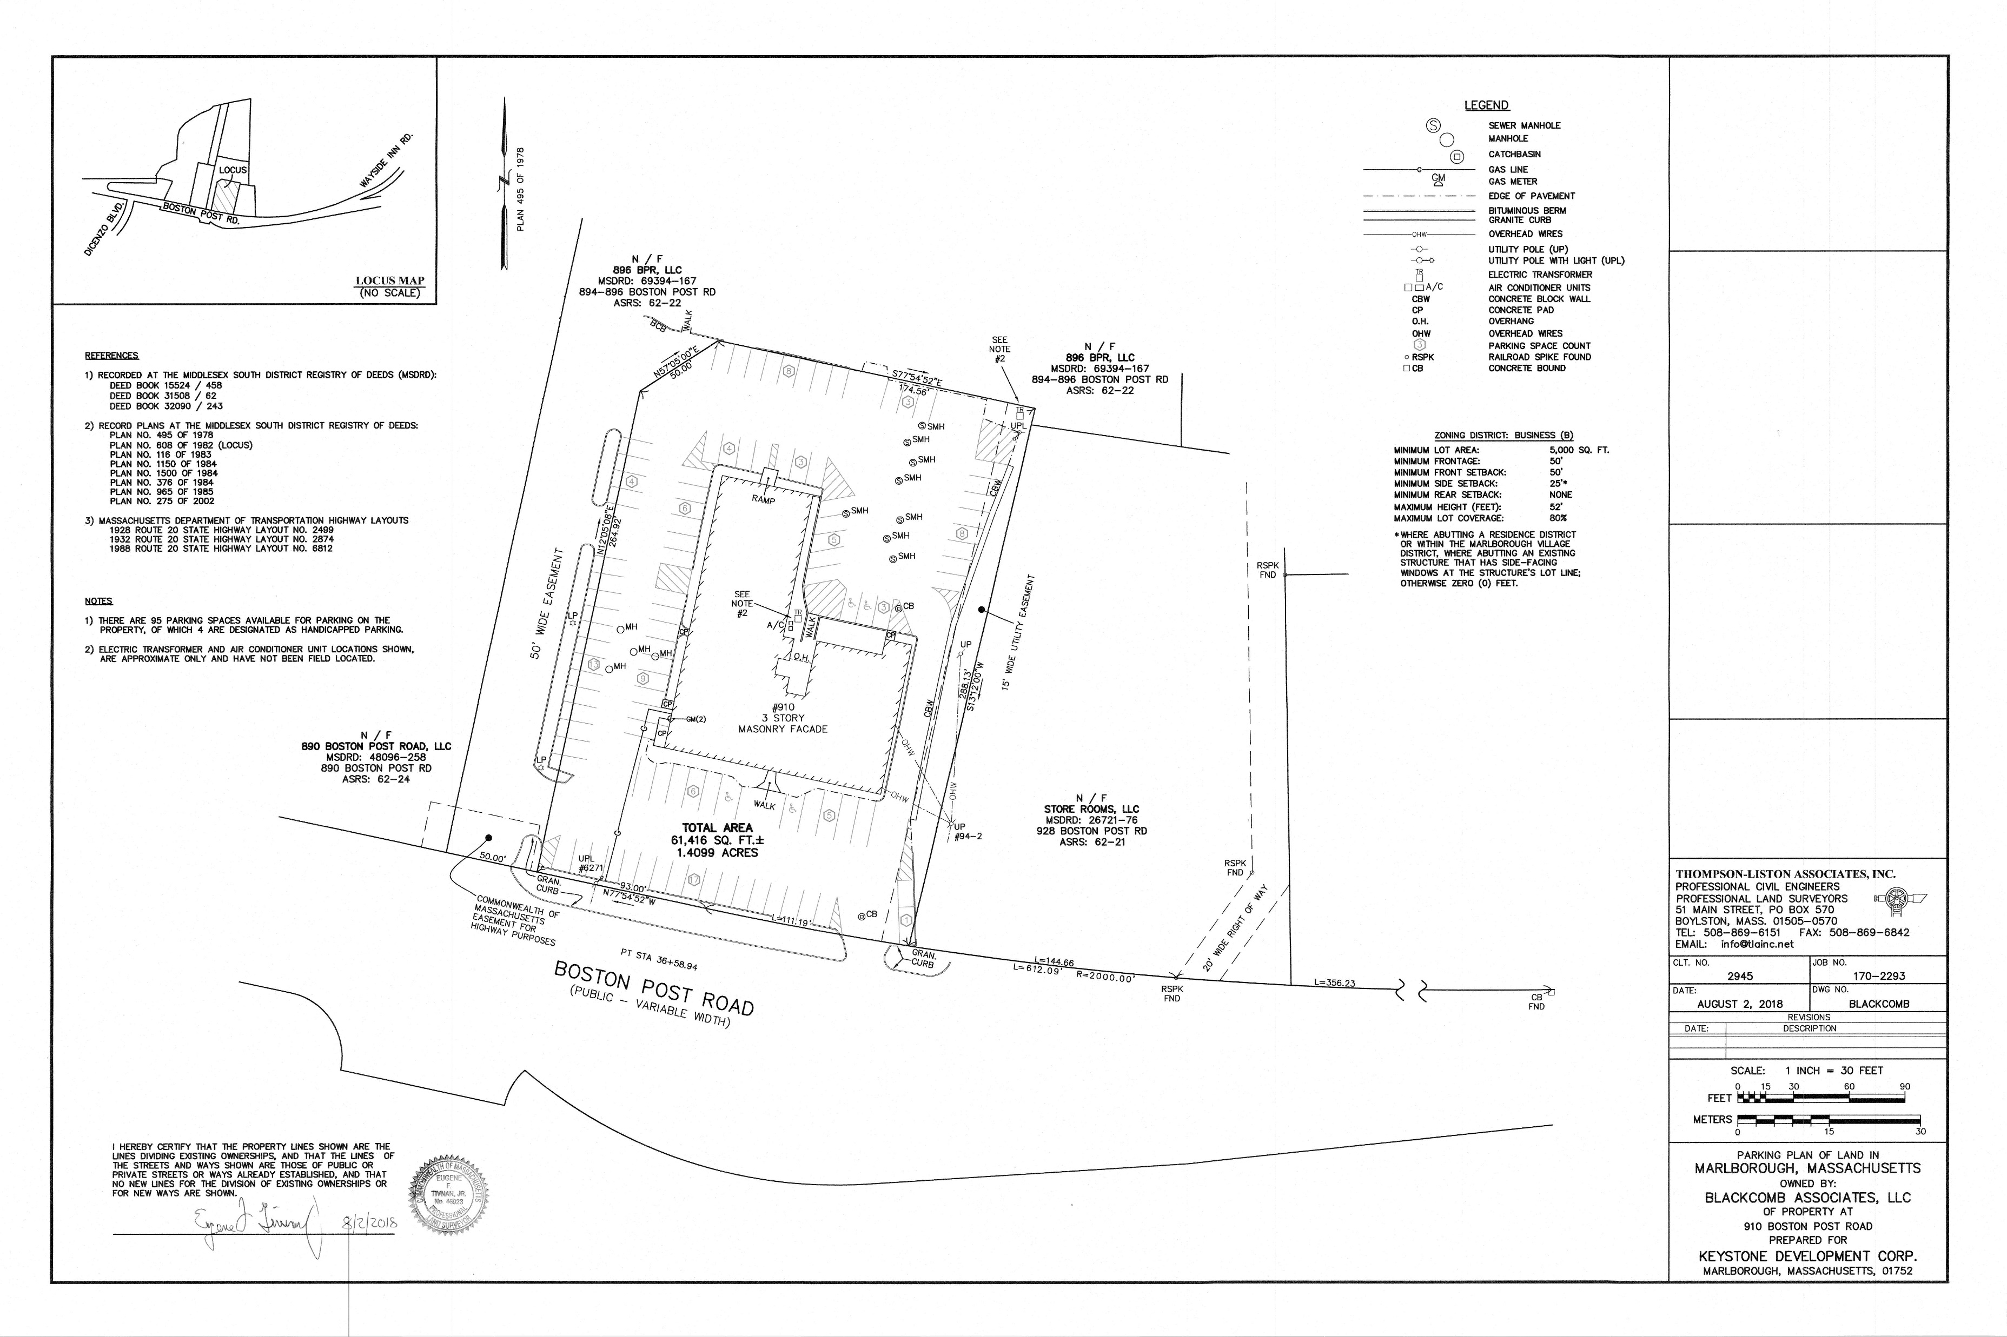

Slide 4
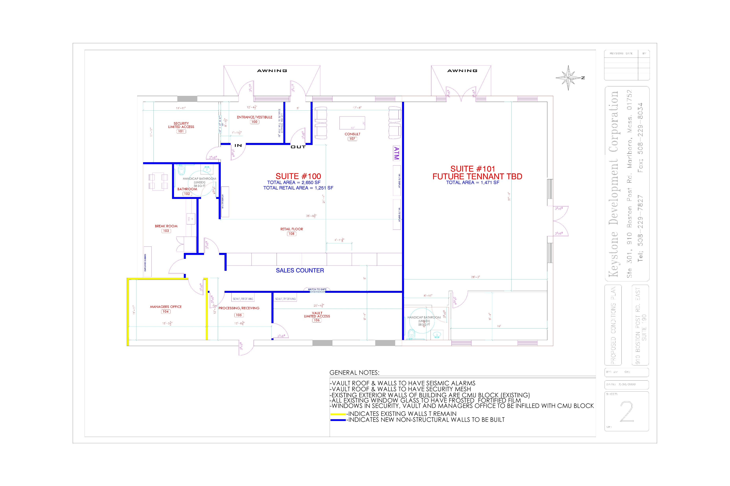
Local Roots Floor Plan

Slide 5
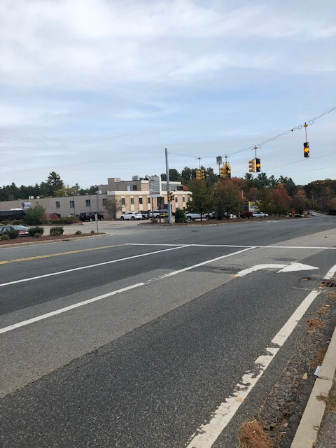
View from Route 20 East

Slide 6
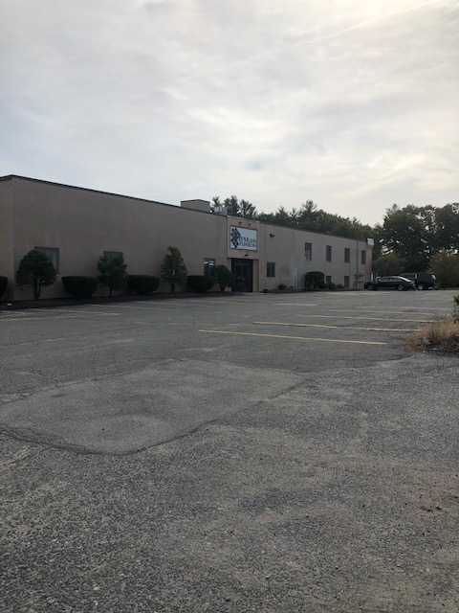
Proposed Store Front

Slide 7
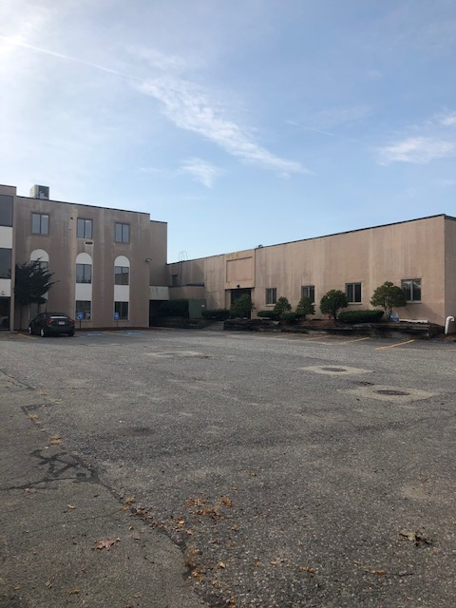
Rear parking area

