Slide 1
City Council FY2022 Tax Classification Public Hearing December 6, 2021

Slide 2
Fiscal Year 2022 Levy
Fiscal year 2021 levy limit | $150,058,642
Levy increase allowed under Prop. 2 ½ | $3,751,466
New growth revenue | $1,992,310
Proposition 2 ½ overrides | -0-
Fiscal year 2022 levy limit | $155,802,418
Levy ceiling | $174,916,520
Levy to be raised | $110,772,481
Excess levy capacity | $45,029,937

Slide 3
Fiscal Year 2022 Valuations
Major Property Class | Valuation | Percent | Res vs. CIP %
Residential | $4,899,698,776 | 70.0291% | 70.0291%
Commercial | $1,157,201,619 | 16.5393%
Industrial | $625,607,054 | 8.9415% | 29.9709%
Personal Property | $314,153,340 | 4.4901%
TOTAL | $6,996,660,789 | 100%

Slide 4
With a recommended shift of 1.40, the City of Marlborough tax rate would be:
Property Class | FY2021 | FY2022
Residential | $13.80 | $13.12
Commercial | $24.47 | $22.17
Industrial | $24.47 | $22.17
Personal Property | $24.47 | $22.17

Slide 5
Historical Tax Rates
Fiscal Year | Residential | Commercial - Industrial - Personal Property
2022 | $13.12 | $22.17
2021 | $13.80 | $24.47
2020 | $14.18 | $25.22
2019 | $14.07 | $24.95
2018 | $14.63 | $25.73
2017 | $15.32 | $26.41
2016 | $15.34 | $25.69
2015 | $15.76 | $27.43
2014 | $16.11 | $28.22
2013 | $15.00 | $28.46

Slide 6
Average Tax Changes
Property Type | FY22 Value | Avg. Tax | FY21 Value | Avg. Tax | Change | % Change
Single-Family Homes | $431,183 | $5,657 | $404,682 | $5,585 | $72 | 1.29%
Condominiums | $247,401 | $3,246 | $237,066 | $3,272 | -$26 | -0.80%
2-Family Homes | $412,960 | $5,418 | $352,239 | $4,861 | $557 | 11.46%
3-Family Homes | $467,698 | $6,136 | $420,902 | $5,808 | $328 | 5.65%
Commercial | $2,120,513 | $47,012 | $2,103,679 | $51,477 | -$4,465 | -8.67%
Industrial | $2,404,974 | $53,318 | $2,501,432 | $61,210 | -$7,892 | -12.89%

Slide 7
Tax Classification – 5 Year Review
 | FY2018 | FY2019 | FY2020 | FY2021
Total New Growth | $3,431,743 | $3,486,714 | $2,634,488 | $2,342,449
Total Tax Levy | $97,680,293 | $104,012,867 | $109,050,542 | $111,497,172
Levy Limit | $131,259,954 | $138,028,167 | $144,113,359 | $150,058,642
Excess Capacity | $33,579,661 | $34,015,300 | $35,062,817 | $38.561,470
Levy Ceiling | $134,766,478 | $149,027,078 | $154,550,088 | $162,883,196
Total Residential Value | $3,695,618,523 | $4,109,940,820 | $4,245,464,143 | $4,491,621,349
Commercial Value | $977,732,325 | $1,066,120,892 | $1,104,461,592 | $1,142,056,340
Industrial Value | $452,841,409 | $508,233,757 | $555,452,644 | $605,738,239
Personal Property Value | $264,466,850 | $276,787,640 | $276,625,140 | $275,911,920
Total Net Taxable Value | $5,390,659,107 | $5,961,083,109 | $6,182,003,519.00 | $6,515,327,848
Residential Value Share | 68.56% | 68.95% | 68.67% | 68.94%
CIP Value Share | 31.44% | 31.05% | 32.32% | 31.06%
Selected Shift | 1.42 | 1.43 | 1.43 | 1.43
Residential Levy Percent | 55.35% | 55.53% | 55.21% | 55.58%
CIP Levy Percent | 44.65% | 44.47% | 44.79% | 44.42%
Residential Levy | $54,066,899 | $57,826,867 | $60,200,978 | $61,973,694
CIP Levy | $43,613,394 | $46,186,000 | $48,849,541 | $49,523,477
Residential Tax Rate | 14.63 | 14.07 | 14.25 | 13.80
Commercial Tax Rate | 25.73 | 24.95 | 25.34 | 24.47
Total Single-Family Value | $2,443,219,500 | $2,643,845,400 | $2,710,805,300 | $2,857,862,300
Single-Family Parcels | 7,043 | 7,055 | 7,061 | 7,062
Average Single-Family Value | $346,900 | $374,748 | $383,913 | $404,682
Average Single-Family Tax Bill | $5,075 | $5,273 | $5,444 | $5,585
FY2022
$1,992,310
$110,772,481
$155,802,418
$45,029,937
$174,916,520
$4,899,698,776
$1,157,201,619
$625,607,054
$314,153,340
$6,996,660,789
70.0291%
29.9709%
1.40
58.03%
41.97%
$64,284,048
$46,488,433
13.12
22.17
$3,046,739,000
7,066
$431,183
$5,657

Slide 8
City of Marlborough Levy Limit Implications
Fiscal Year | Total Tax Levy | Maximum Levy Limit | Levy Ceiling | Excess Levy Capacity | Excess as a % of Maximum Levy
2003 | 60,956,295 | 67,335,085 | 100,966,720 | 6,378,790 | 9.47%
2004 | 64,465,084 | 71,046,332 | 103,809,076 | 6,581,248 | 9.26%
2005 | 72,153,233 | 74,876,393 | 109,515,192 | 2,723,160 | 3.64%
2006 | 72,181,560 | 78,548,734 | 122,053,673 | 6,367,174 | 8.11%
2007 | 79,018,938 | 84,655,918 | 127,934,312 | 5,636,980 | 6.66%
2008 | 79,753,097 | 89,384,611 | 128,148,285 | 9,631,514 | 10.78%
2009 | 81,935,337 | 94,575,164 | 129,533,857 | 12,639,827 | 13.36%
2010 | 80,996,050 | 98,943,862 | 117,902,971 | 17,947,812 | 18.14%
2011 | 83,511,878 | 103,447,705 | 113,672,828 | 19,935,827 | 19.27%
2012 | 85,845,867 | 108,330,504 | 110,863,797 | 22,484,637 | 20.76%
2013 | 86,361,360 | 111,500,706 | 111,500,706 | 25,139,346 | 22.55%
2014 | 88,052,213 | 109,200,278 | 109,200,278 | 21,148,065 | 19.37%
2015 | 88,678,940 | 113,153,270 | 113,153,270 | 24,474,330 | 21.63%
2016 | 91,331,454 | 119,963,736 | 121,763,573 | 28,632,282 | 23.87%
2017 | 94,119,595 | 124,710,450 | 124,710,450 | 30,590,855 | 24.53%
2018 | 97,680,293 | 131,259,954 | 134,766,478 | 33,579,661 | 25.58%
2019 | 104,012,867 | 138,028,167 | 149,027,078 | 34,015,300 | 24.64%
2020 | 109,050,088 | 144,113,359 | 154,550,088 | 35,062,817 | 24.33%
2021 | 111,497,172 | 150,058,642 | 162,883,196 | 38,561,470 | 25.70%
2022 | 110,772,481 | 155,802,418 | 174,916,520 | 45,029,937 | 28.90%

Slide 16
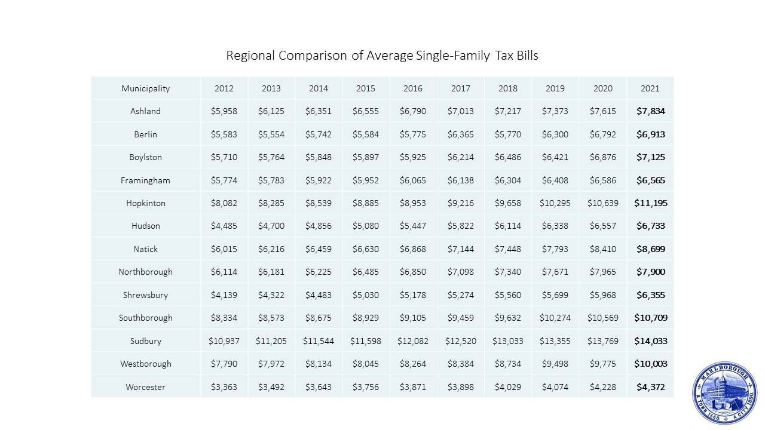

Slide 18
 | Owner | Nature of Business | FY21 Real Estate Tax Bill | FY2021 Value | % of Total Tax Levy
1 | Boston Scientific Corporation | Office Campus | $1,810,898.06 | $74,004,825 | 1.62%
2 | Hines Global REIT Marlborough Campus | Office Campus | $1,785,184.38 | $72,954,000 | 1.60%
3 | TJX Companies, Inc. | Retail-Offices | $1,702,163.51 | $69,561,239 | 1.53%
4 | Avalon Marlborough LLC | Apartment Complex | $1,484,794.44 | $107,593,800 | 1.33%
5 | MTP Equity Partners LLC | Office Campus | $1,218,767.51 | $49,806,600 | 1.09%
6 | Atlantic-Marlboro Realty III LLC | Office-R & D | $1,126,066.70 | $46,018,255 | 1.01%
7 | Walker Reality (APEX) | Retail / Office | $1,121,215.40 | $45,820,000 | 1.01%
8 | Raytheon Company | Computer Management | $1,016,542.53 | $41,542,400 | 0.91%
9 | Shipley Company LLC | Industrial | $956,564.11 | $39,091,300 | 0.86%
10 | Mall At Solomon Pond LLC | Retail | $952,739.46 | $38,935,000 | 0.85%

Slide 19
Top 10 Personal Property Taxpayers for Fiscal Year 2021
 | Taxpayer | Address | FY21 PP Tax Bill | FY21 Value
1 | Oracle America Inc | 250 Locke Dr | $389,342.66 | $15,911,020
2 | Astellas Phar Inc | 33 Locke Drive | $249,555.34 | $10,198,420
3 | Boston Scientific Corp. | Boston Scientific Way | $212,681.01 | $8,691,500
4 | Marvel Semiconductor Inc | 600 Nickerson Road | $180,111.19 | $7,360,490
5 | Wellington Mgmt. Co LLP | 100 Campus Dr | $153,133.99 | $6,258,030
6 | Comcast of MA | Various | $137,789.84 | $5,630,970
7 | Crown Castle Fiber LLC | Various | $134,571.54 | $5,499,450
8 | 2018 ESA Project Comp. | Various | $115,899.95 | $4,736,410
9 | Quest Diagnostics LLC | 200 Forest St | $109,380.90 | $4,470,000
10 | Roche Molecular System | 700 Nickerson Rd | $49,318.80 | $2,015,480

