Slide 1
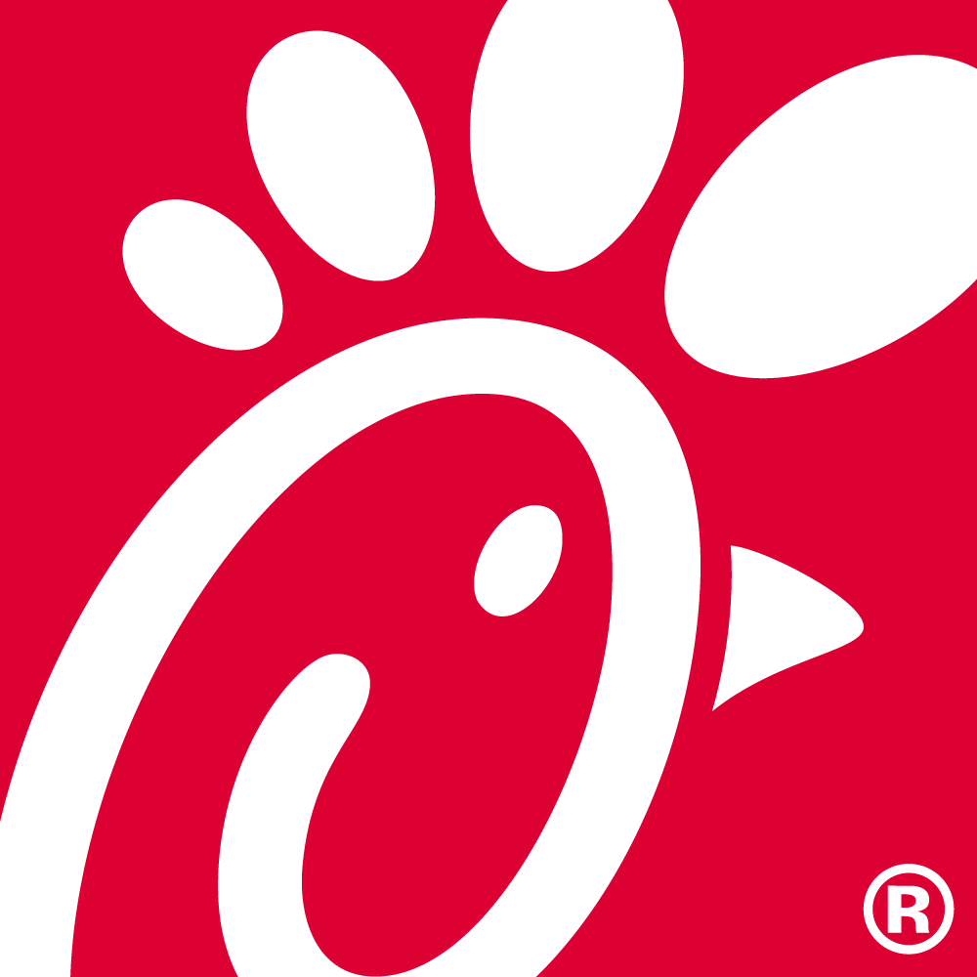
6-7-21 Order No. 21-1008317 Chick-fil-A 36 Apex Drive Urban Affairs Committee Meeting June 29, 2021

Slide 2
Photographic Examples of Existing Canopies

Slide 3
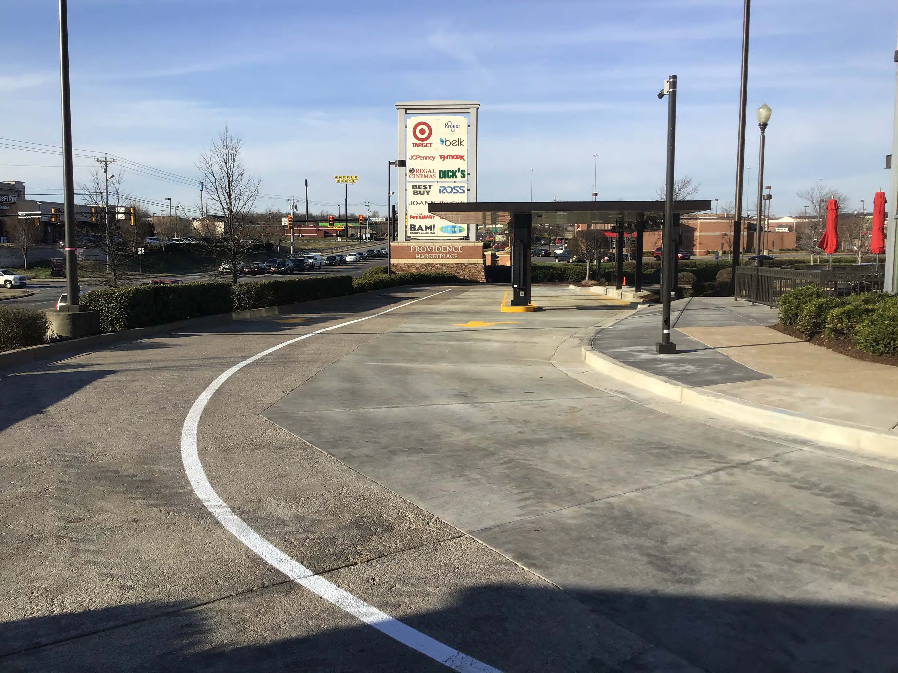

Slide 4
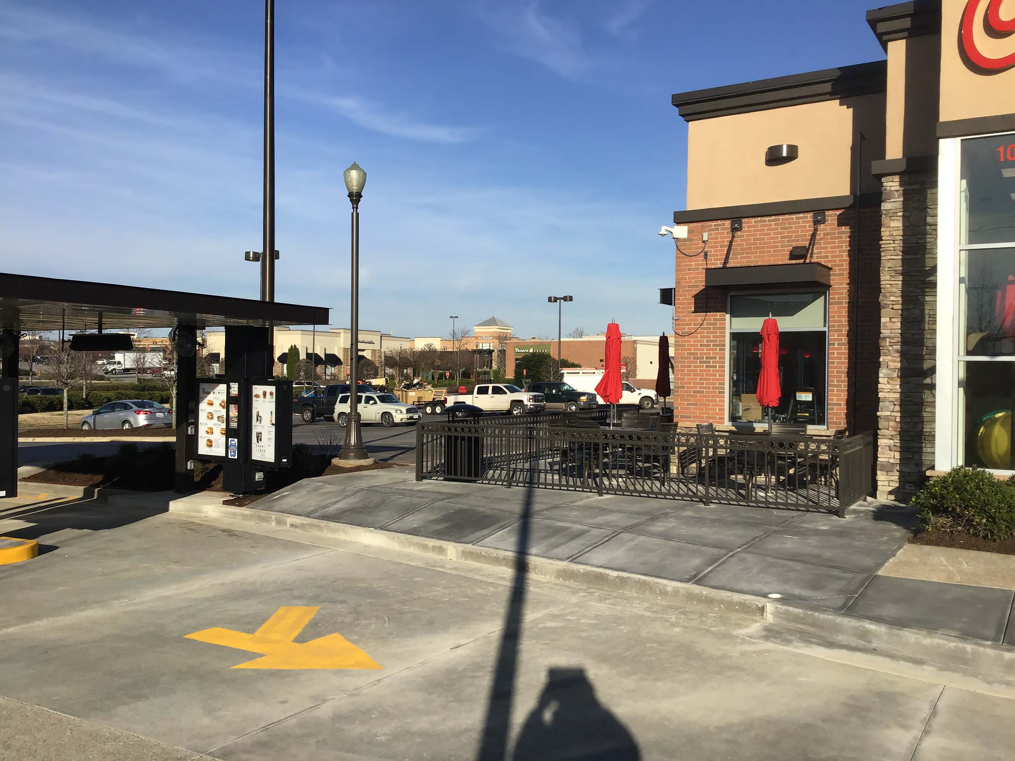

Slide 5
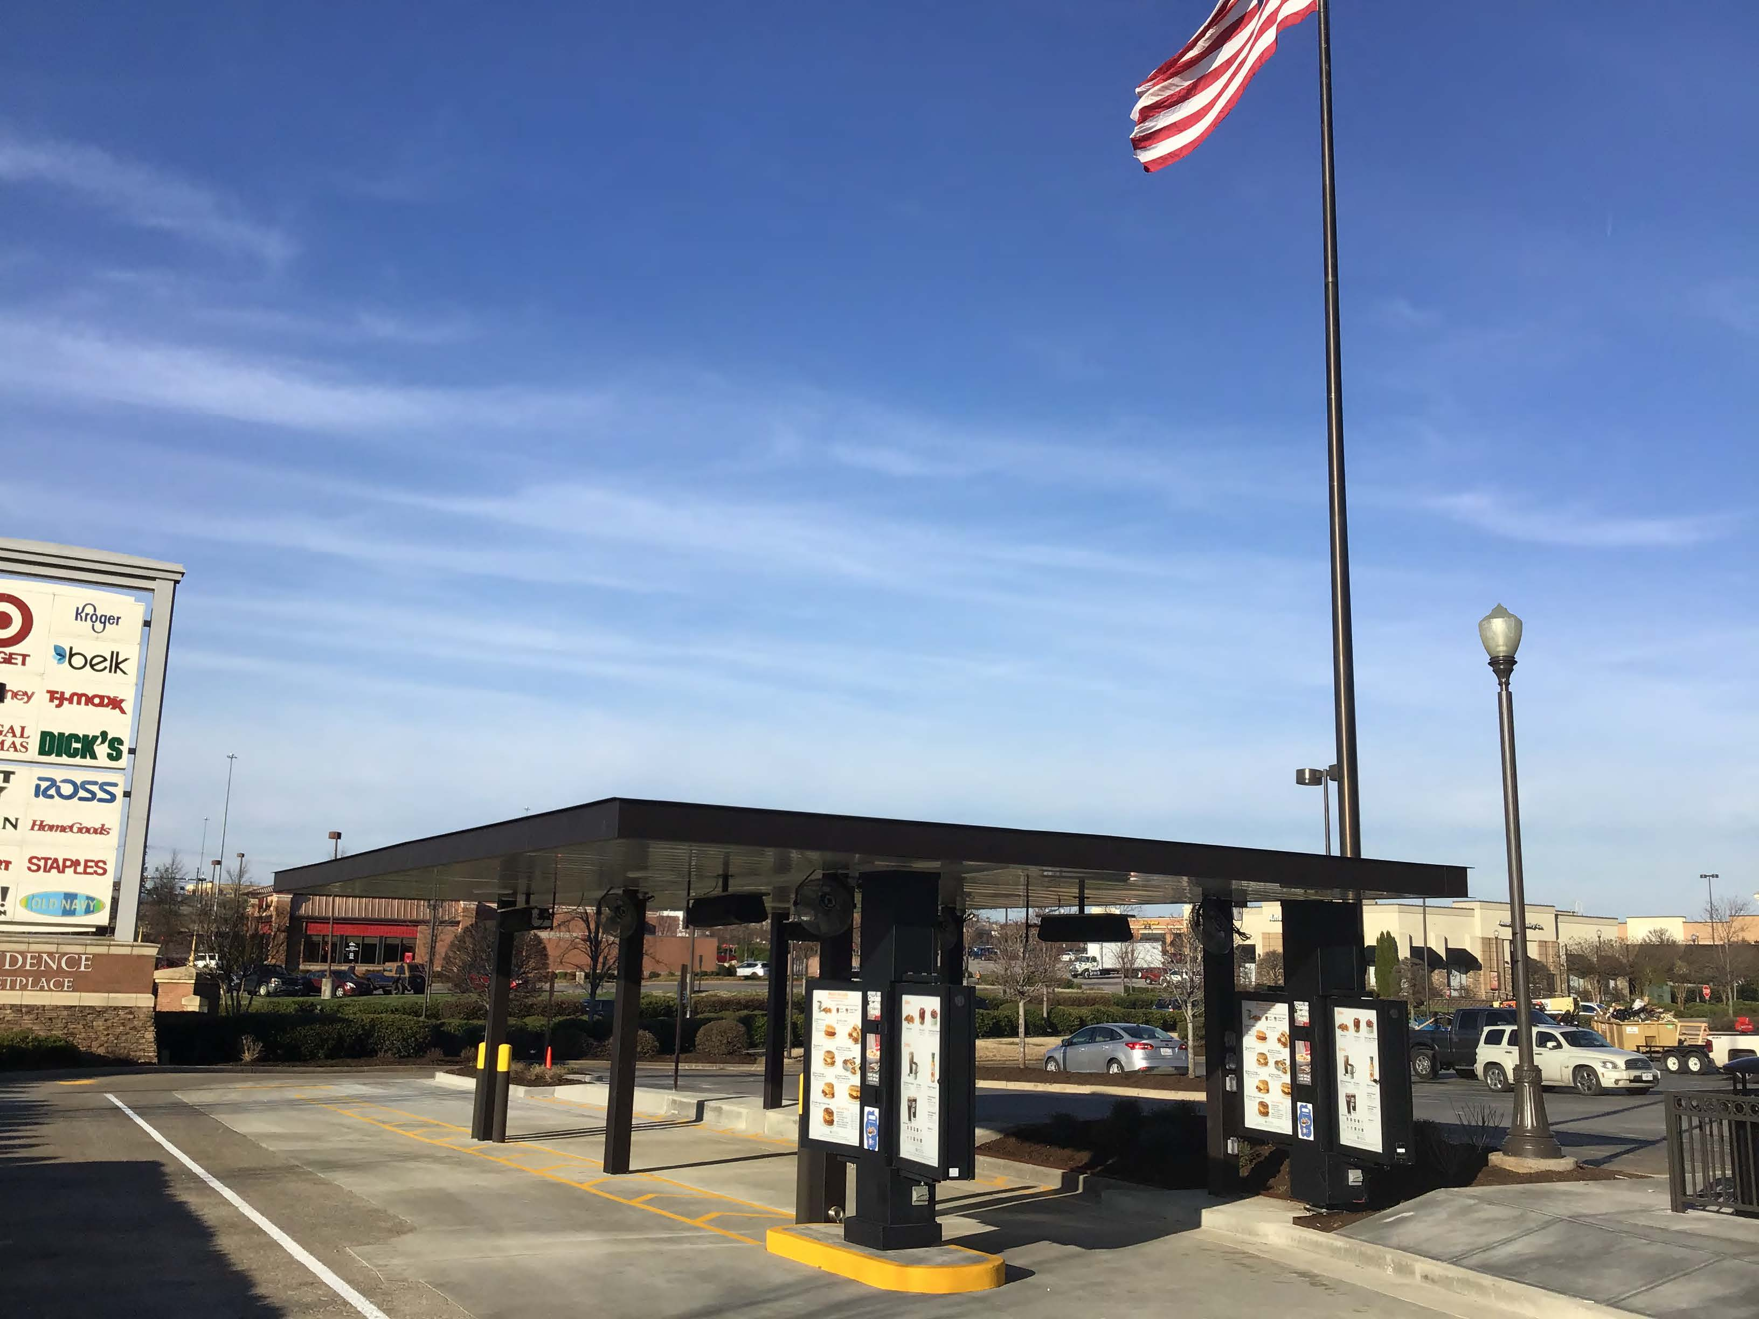

Slide 6
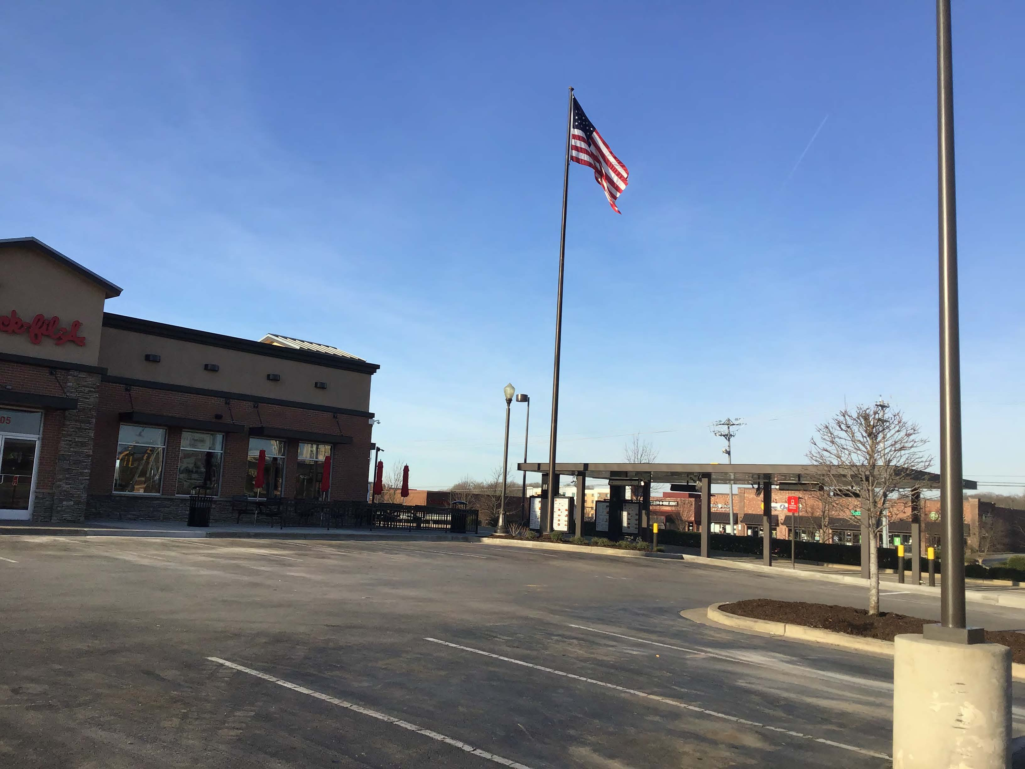

Slide 7
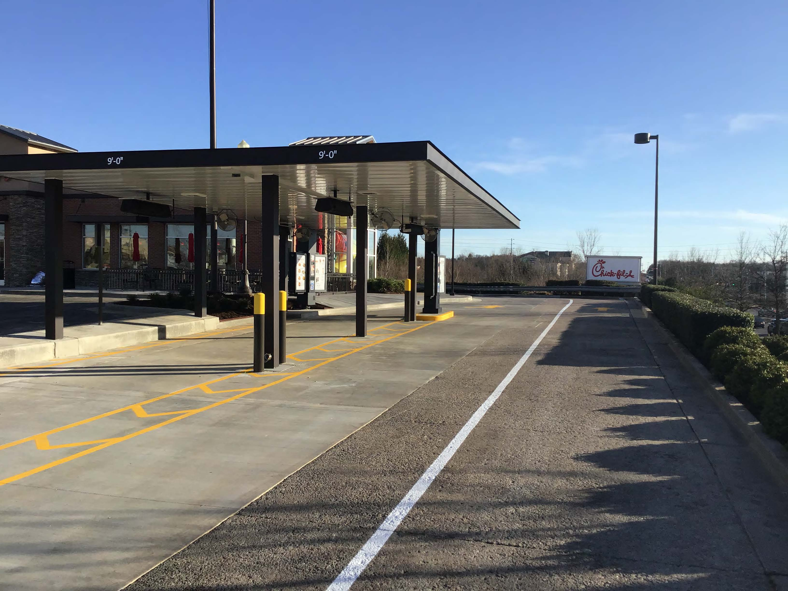

Slide 8
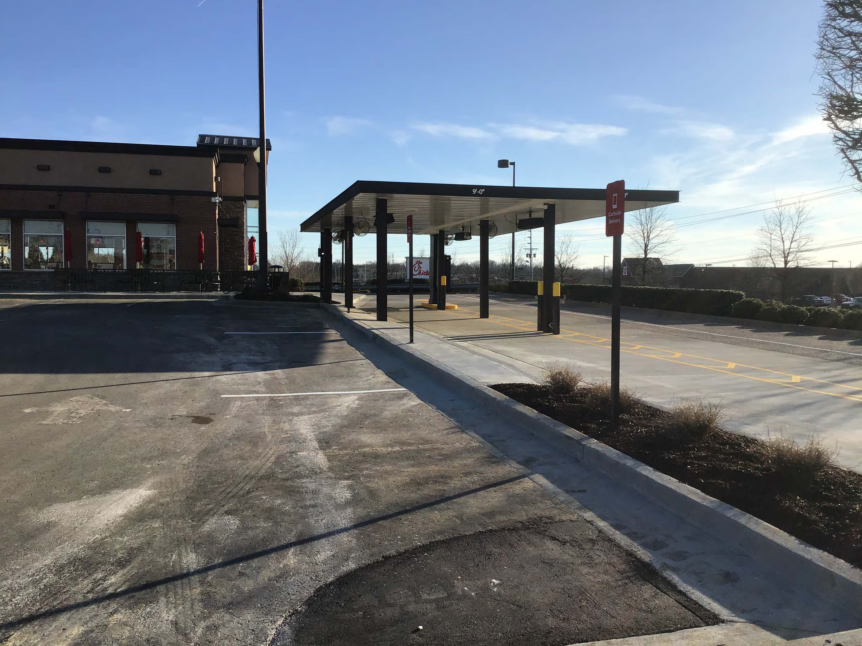

Slide 9
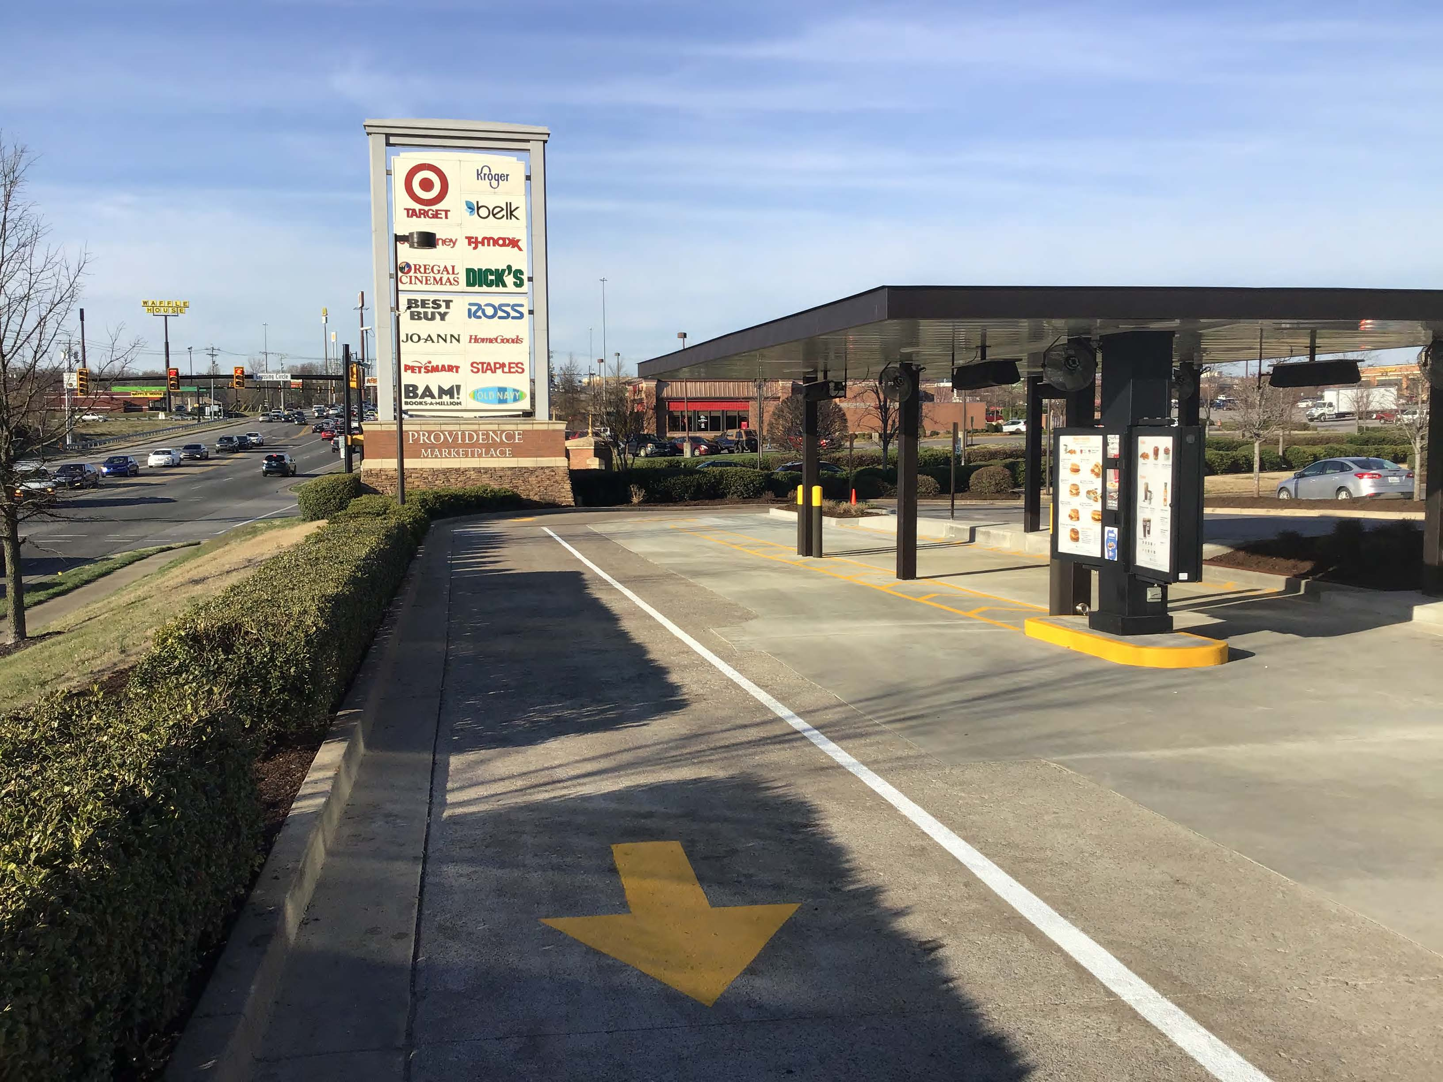

Slide 10
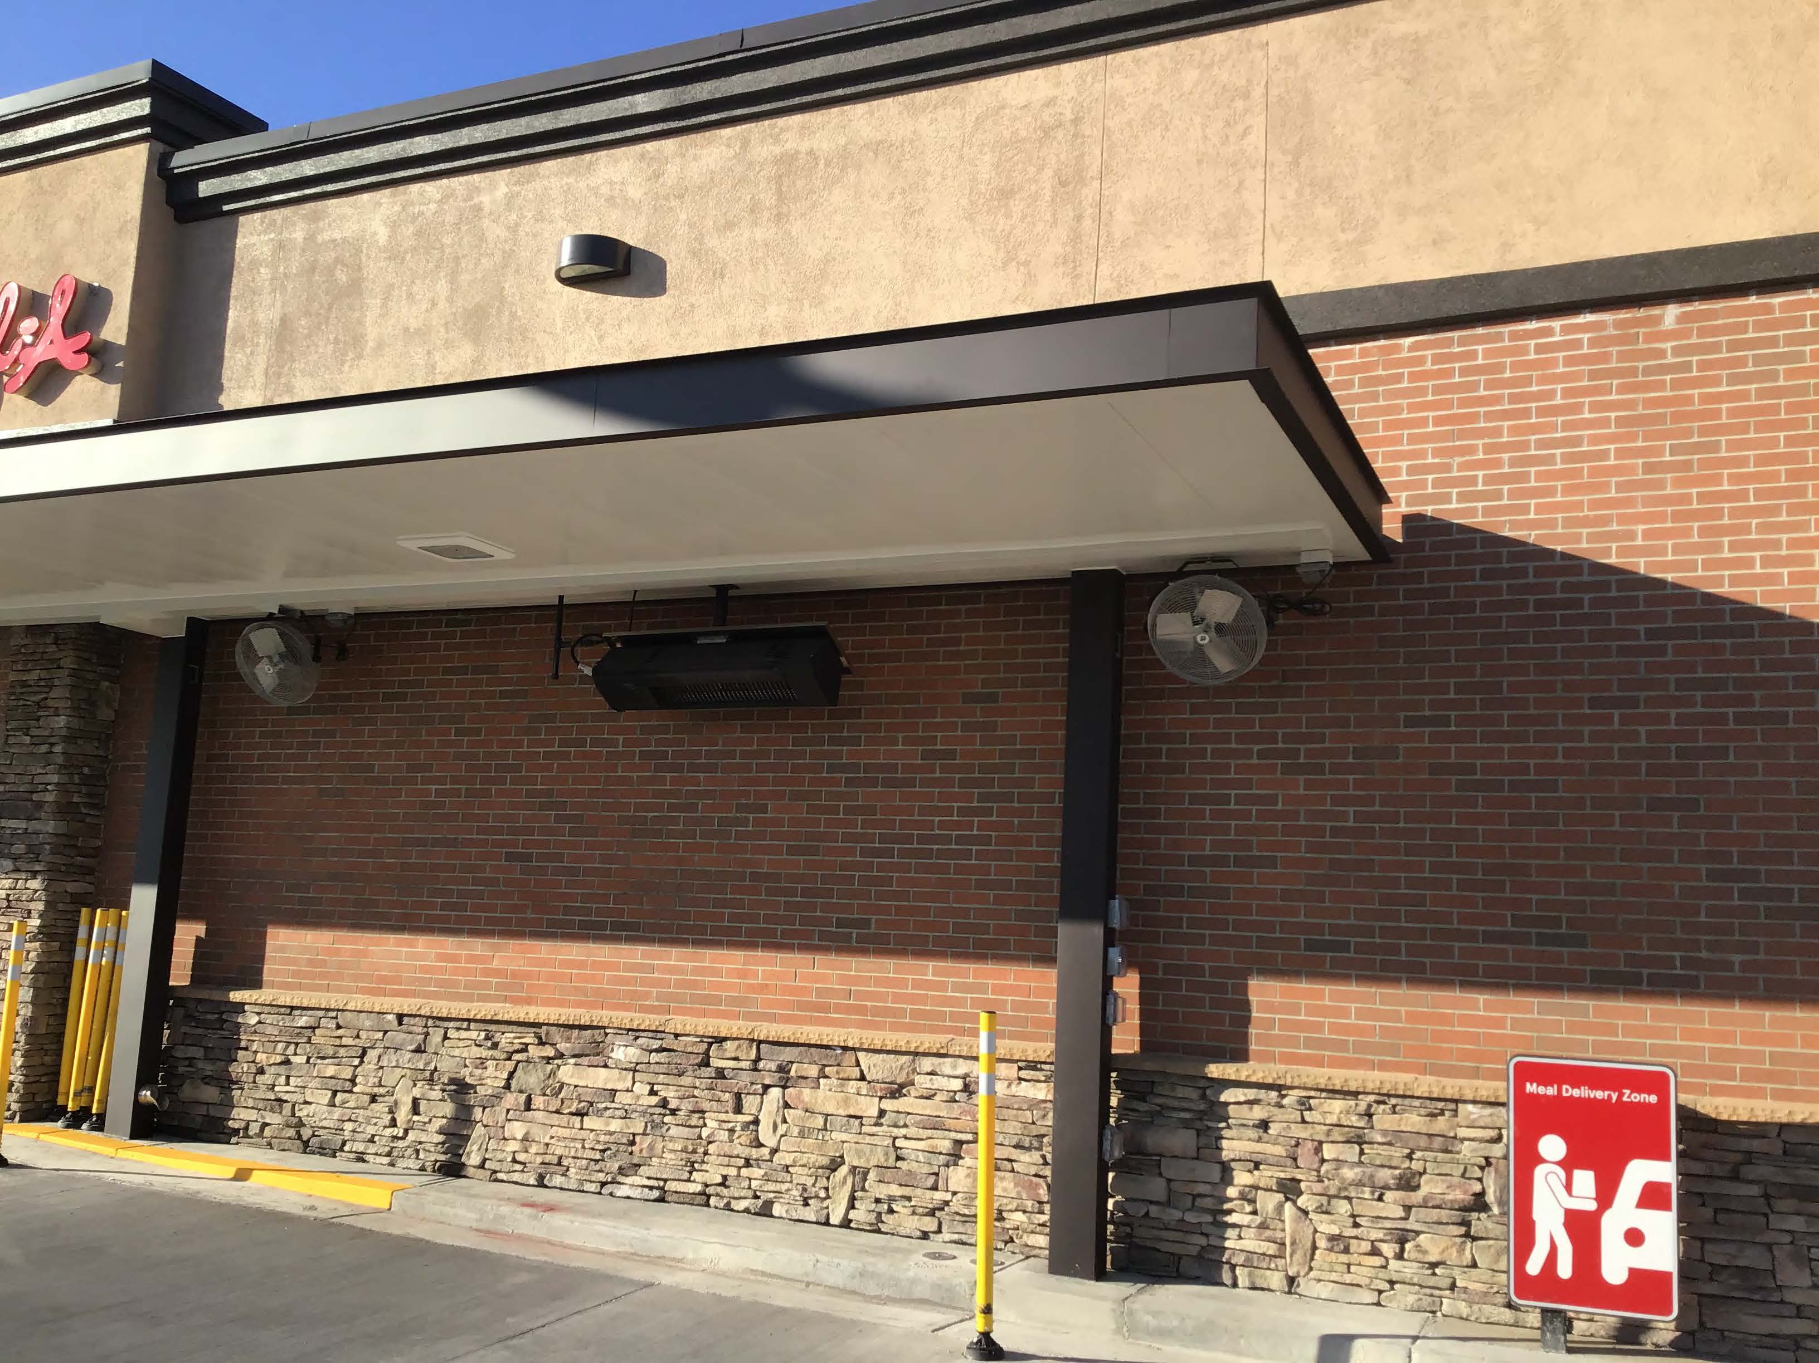

Slide 11
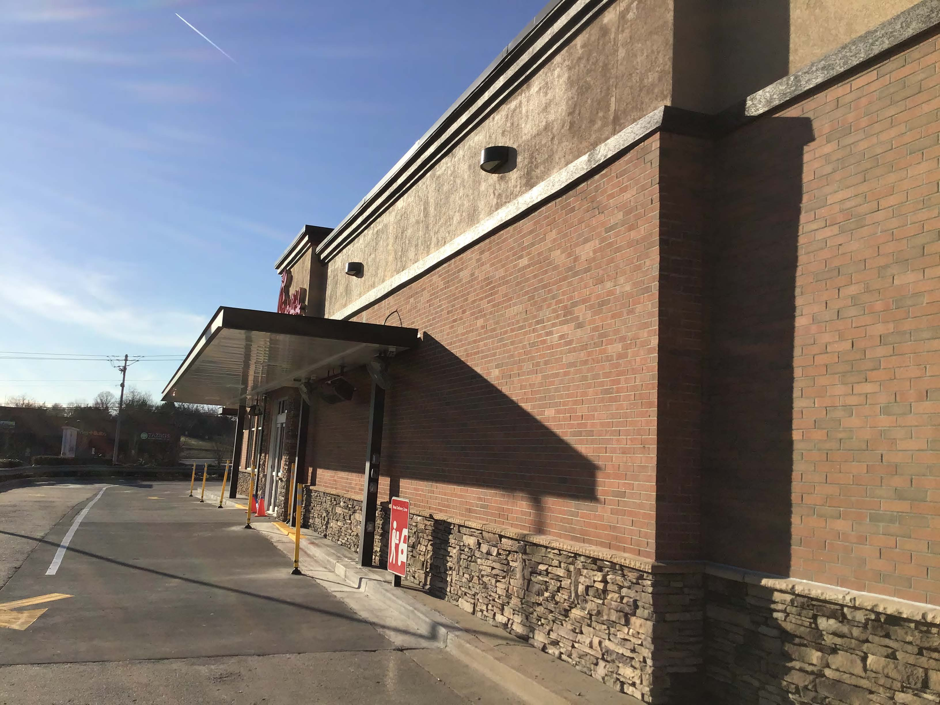

Slide 12
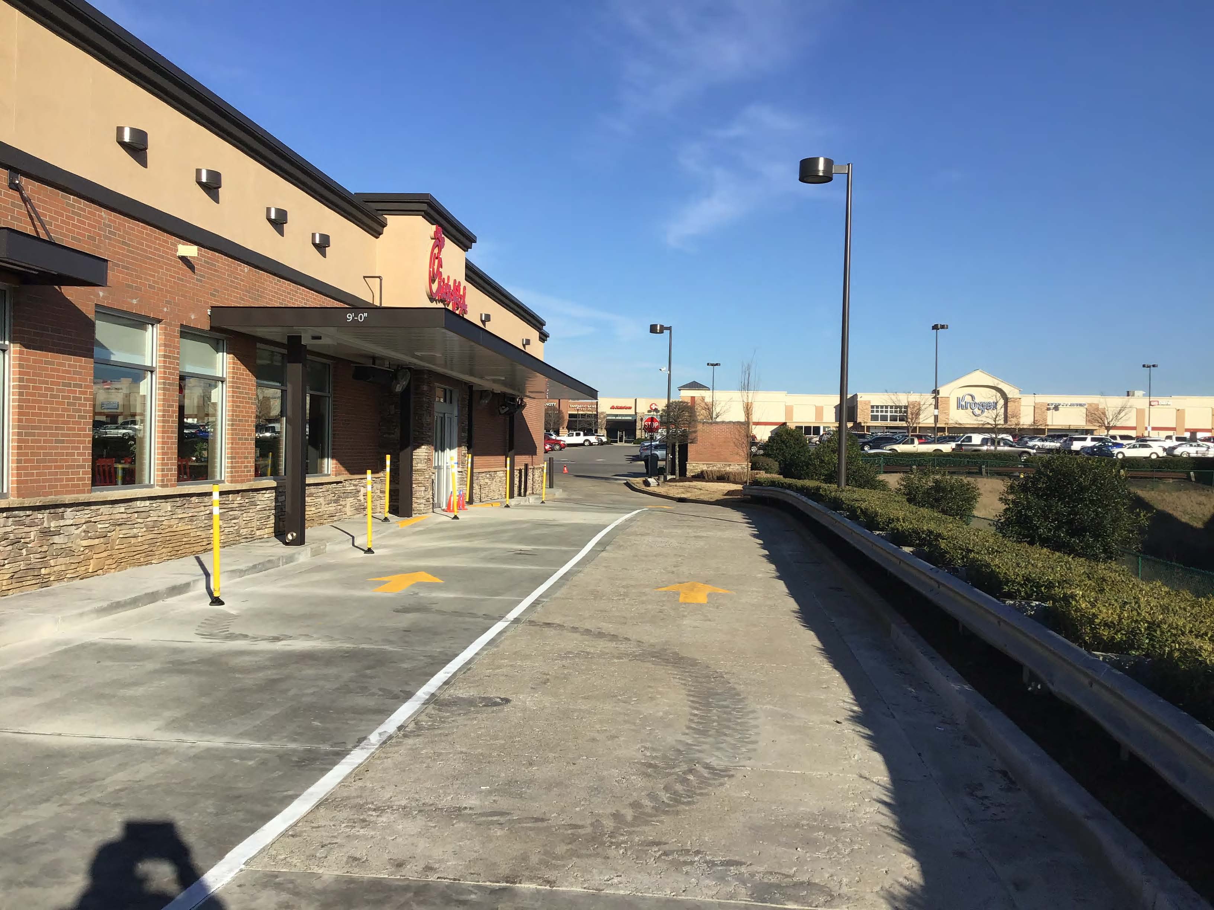

Slide 13
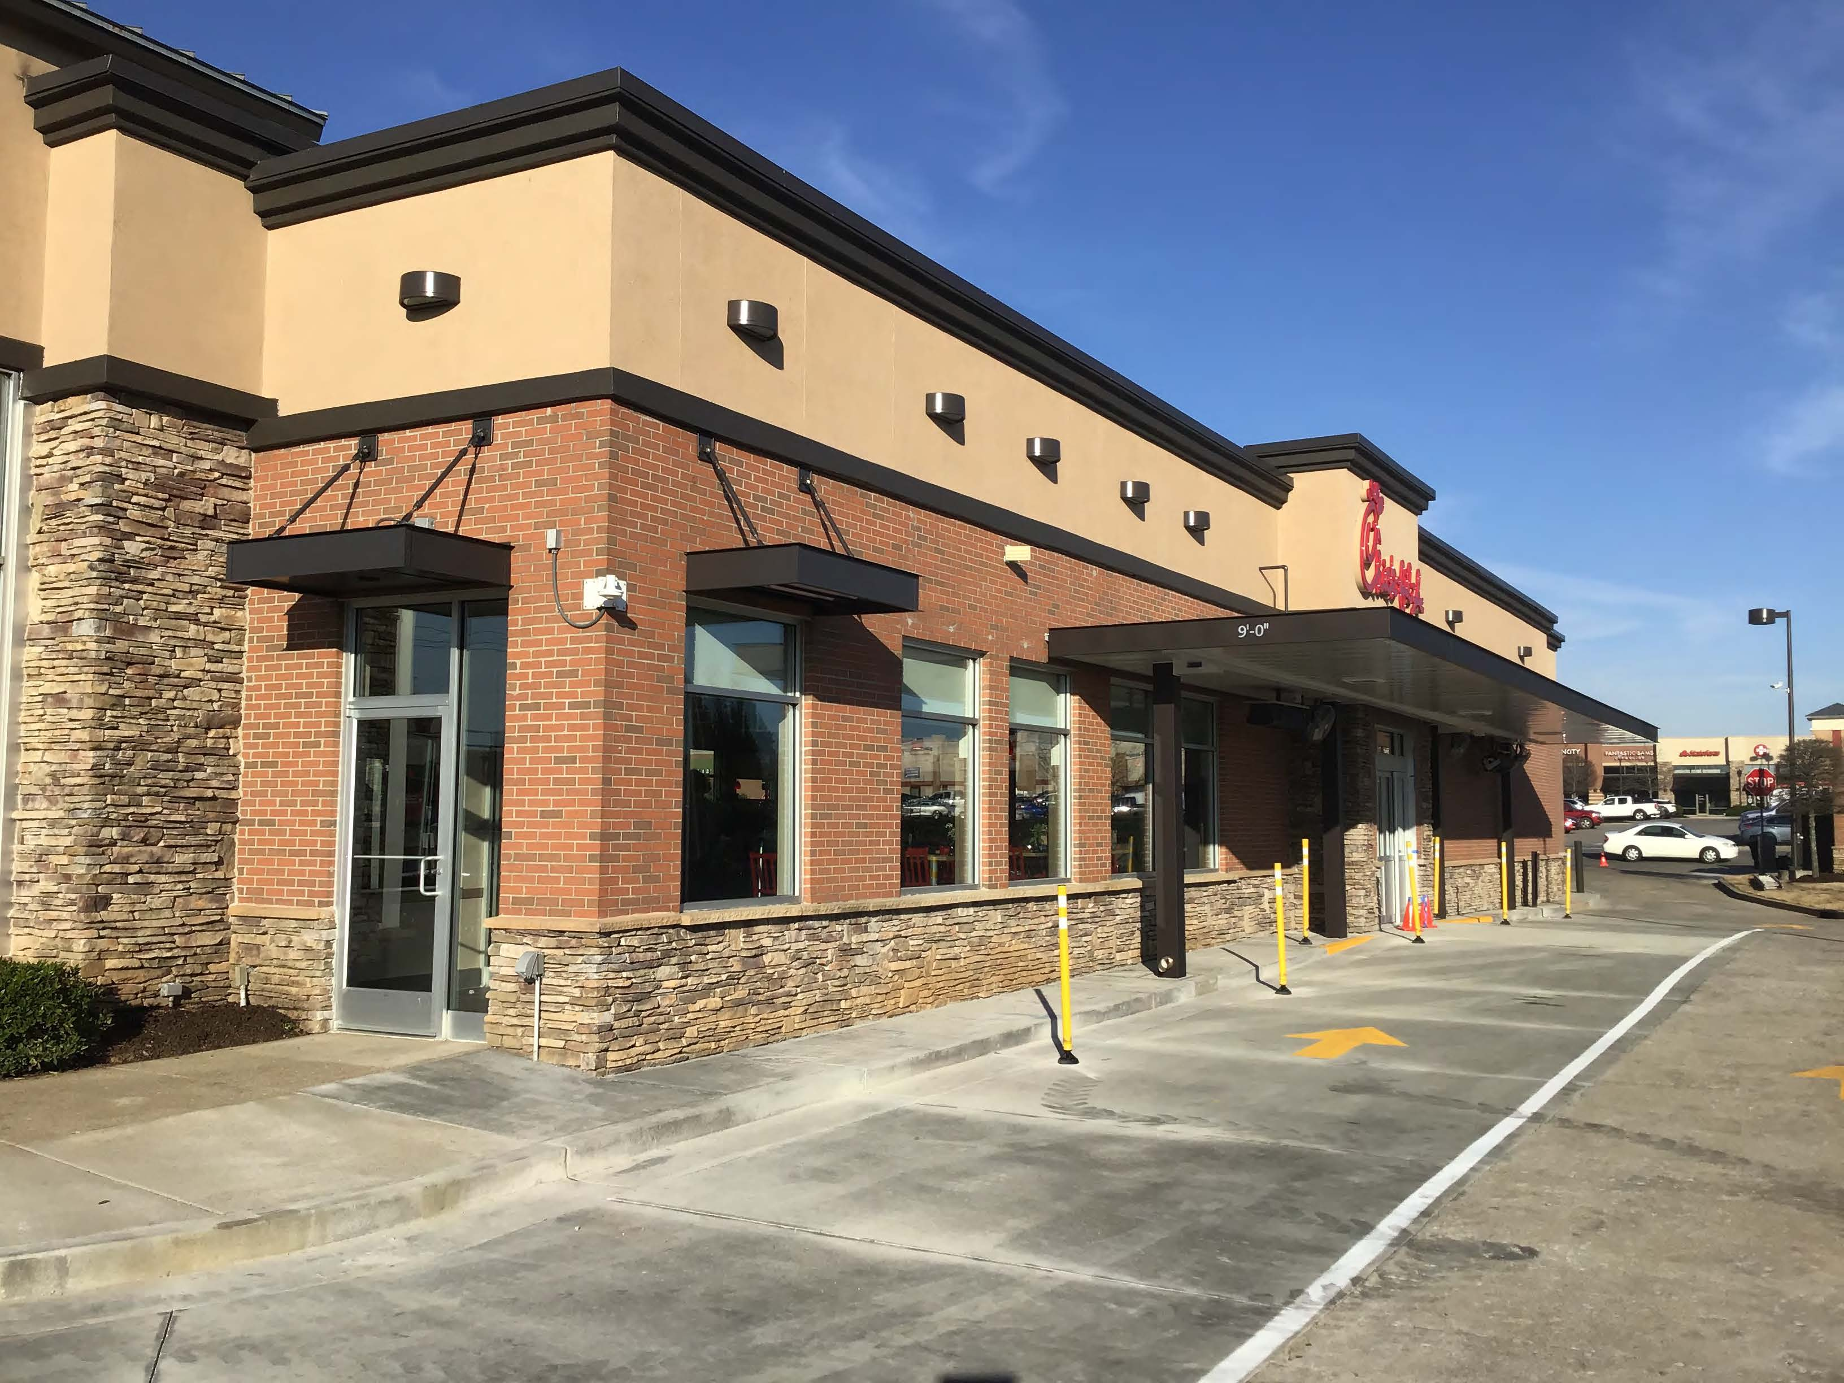

Slide 14
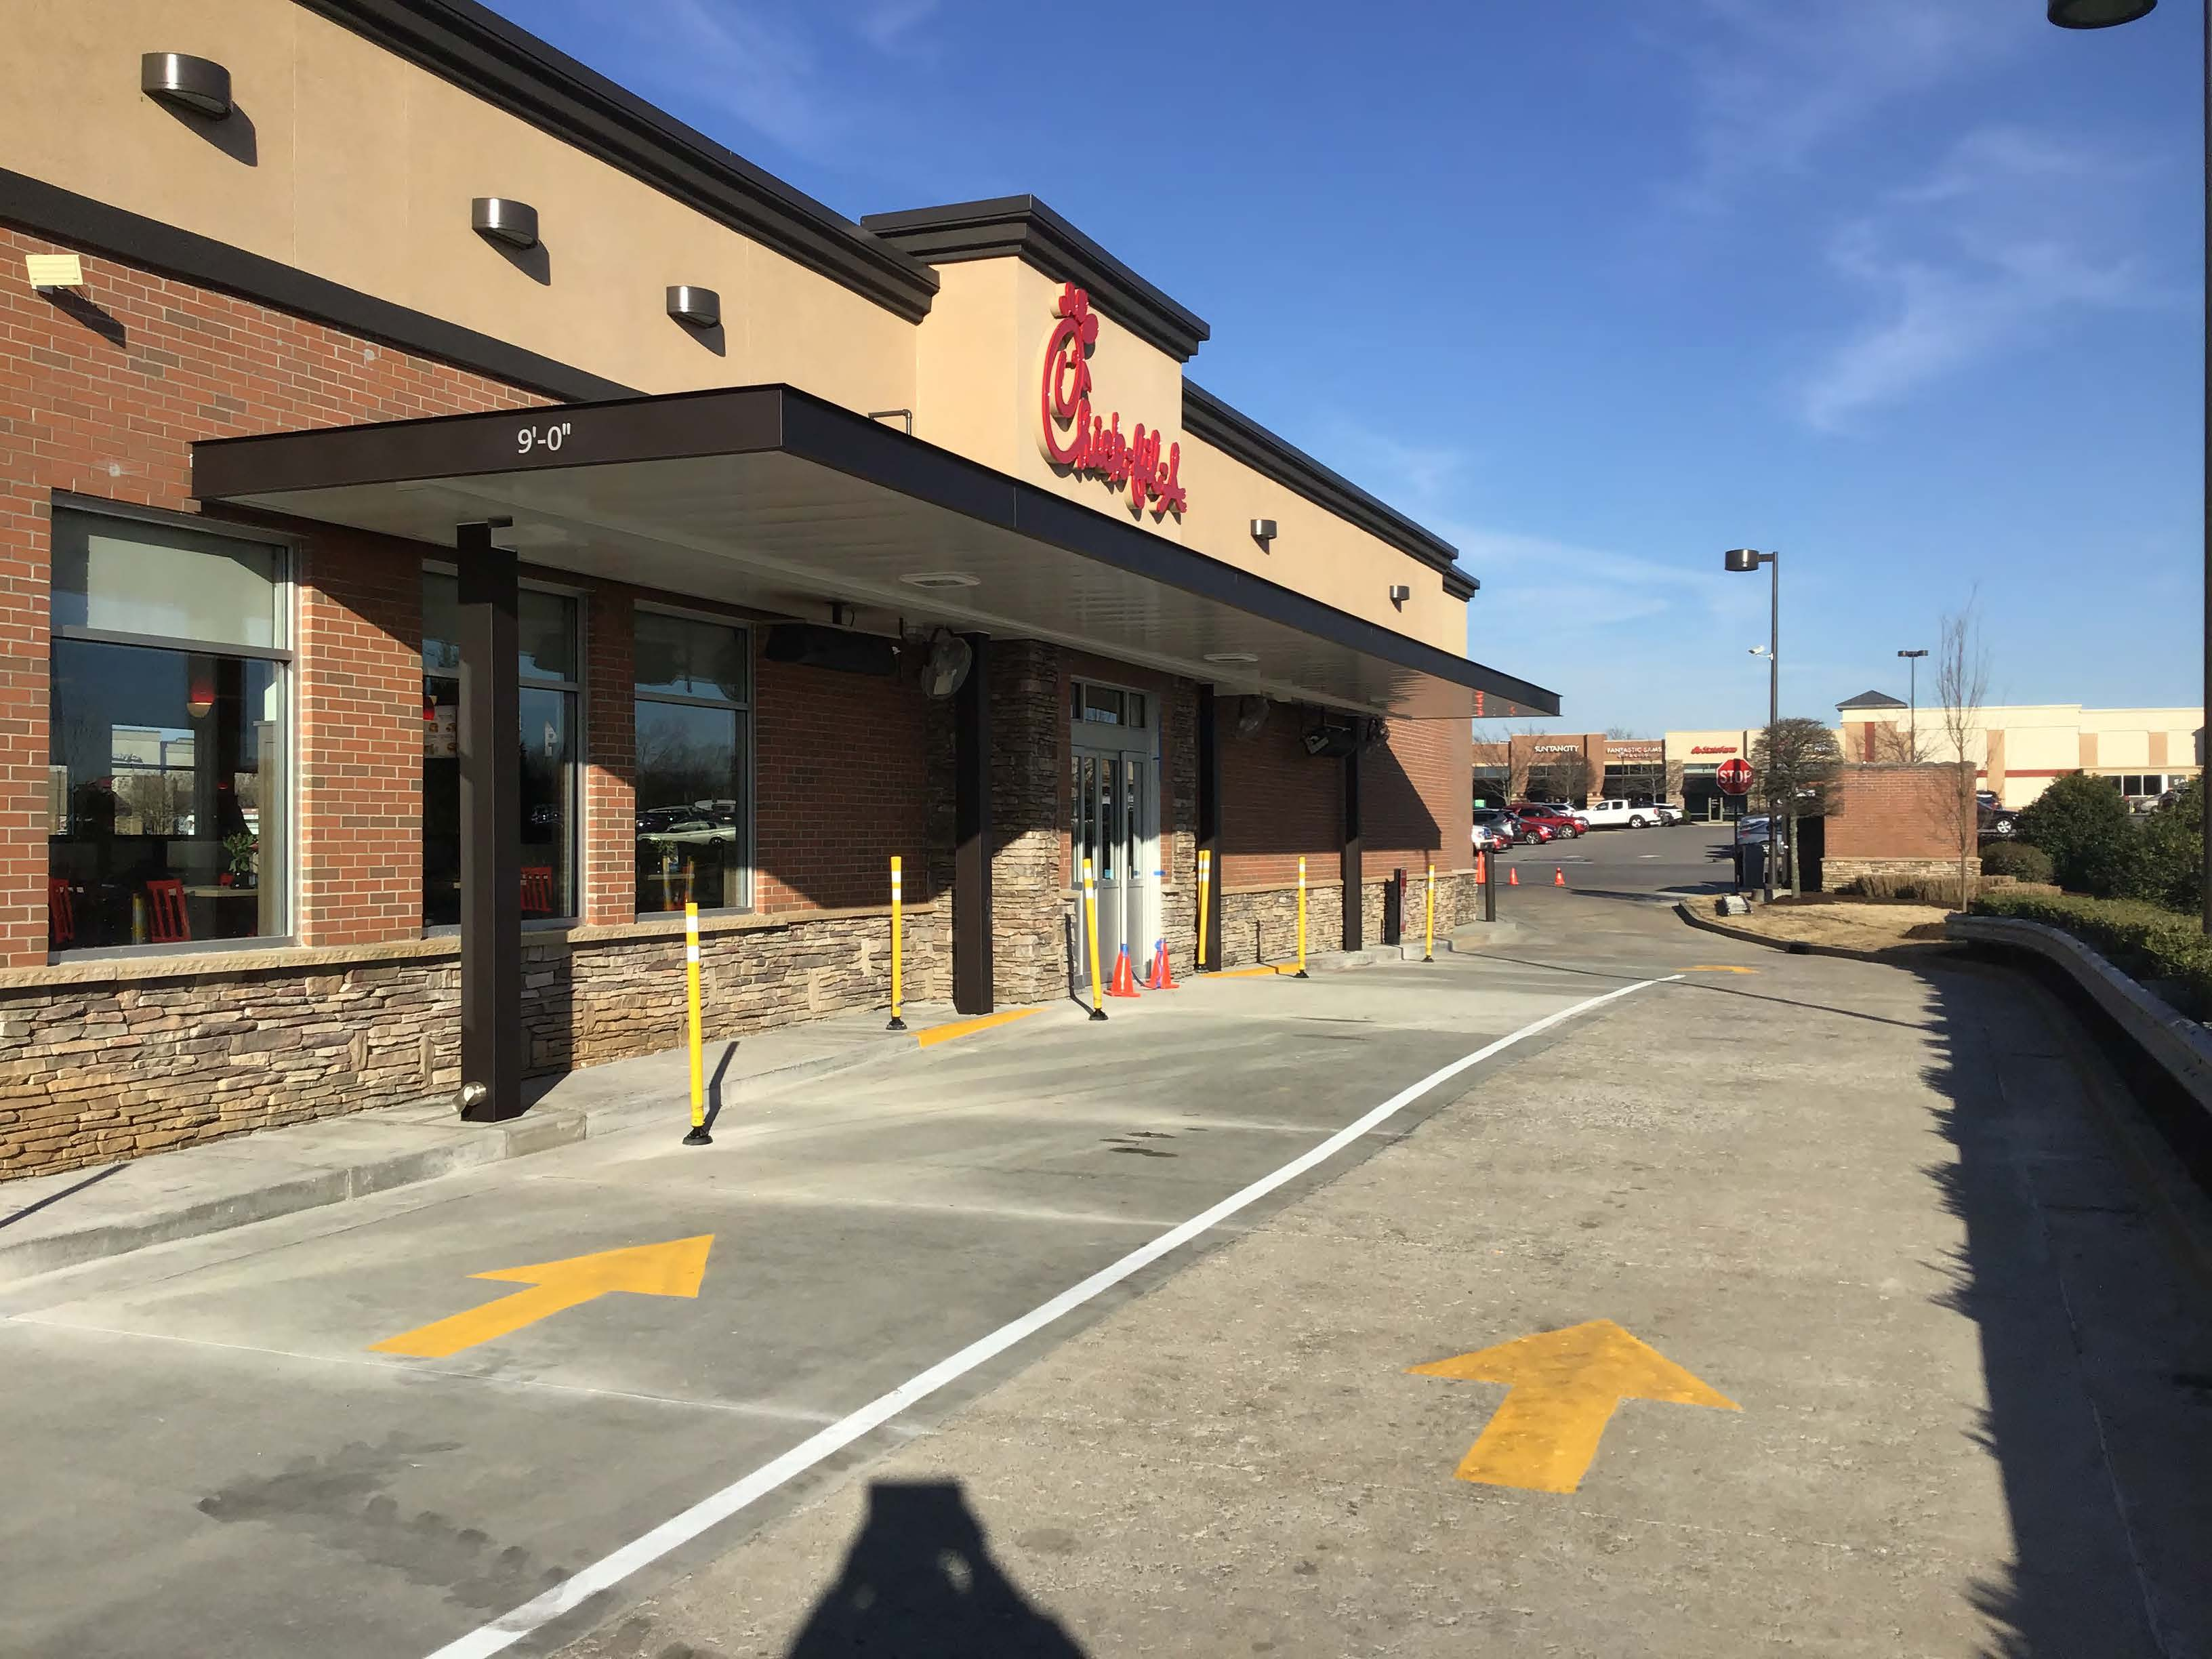

Slide 15
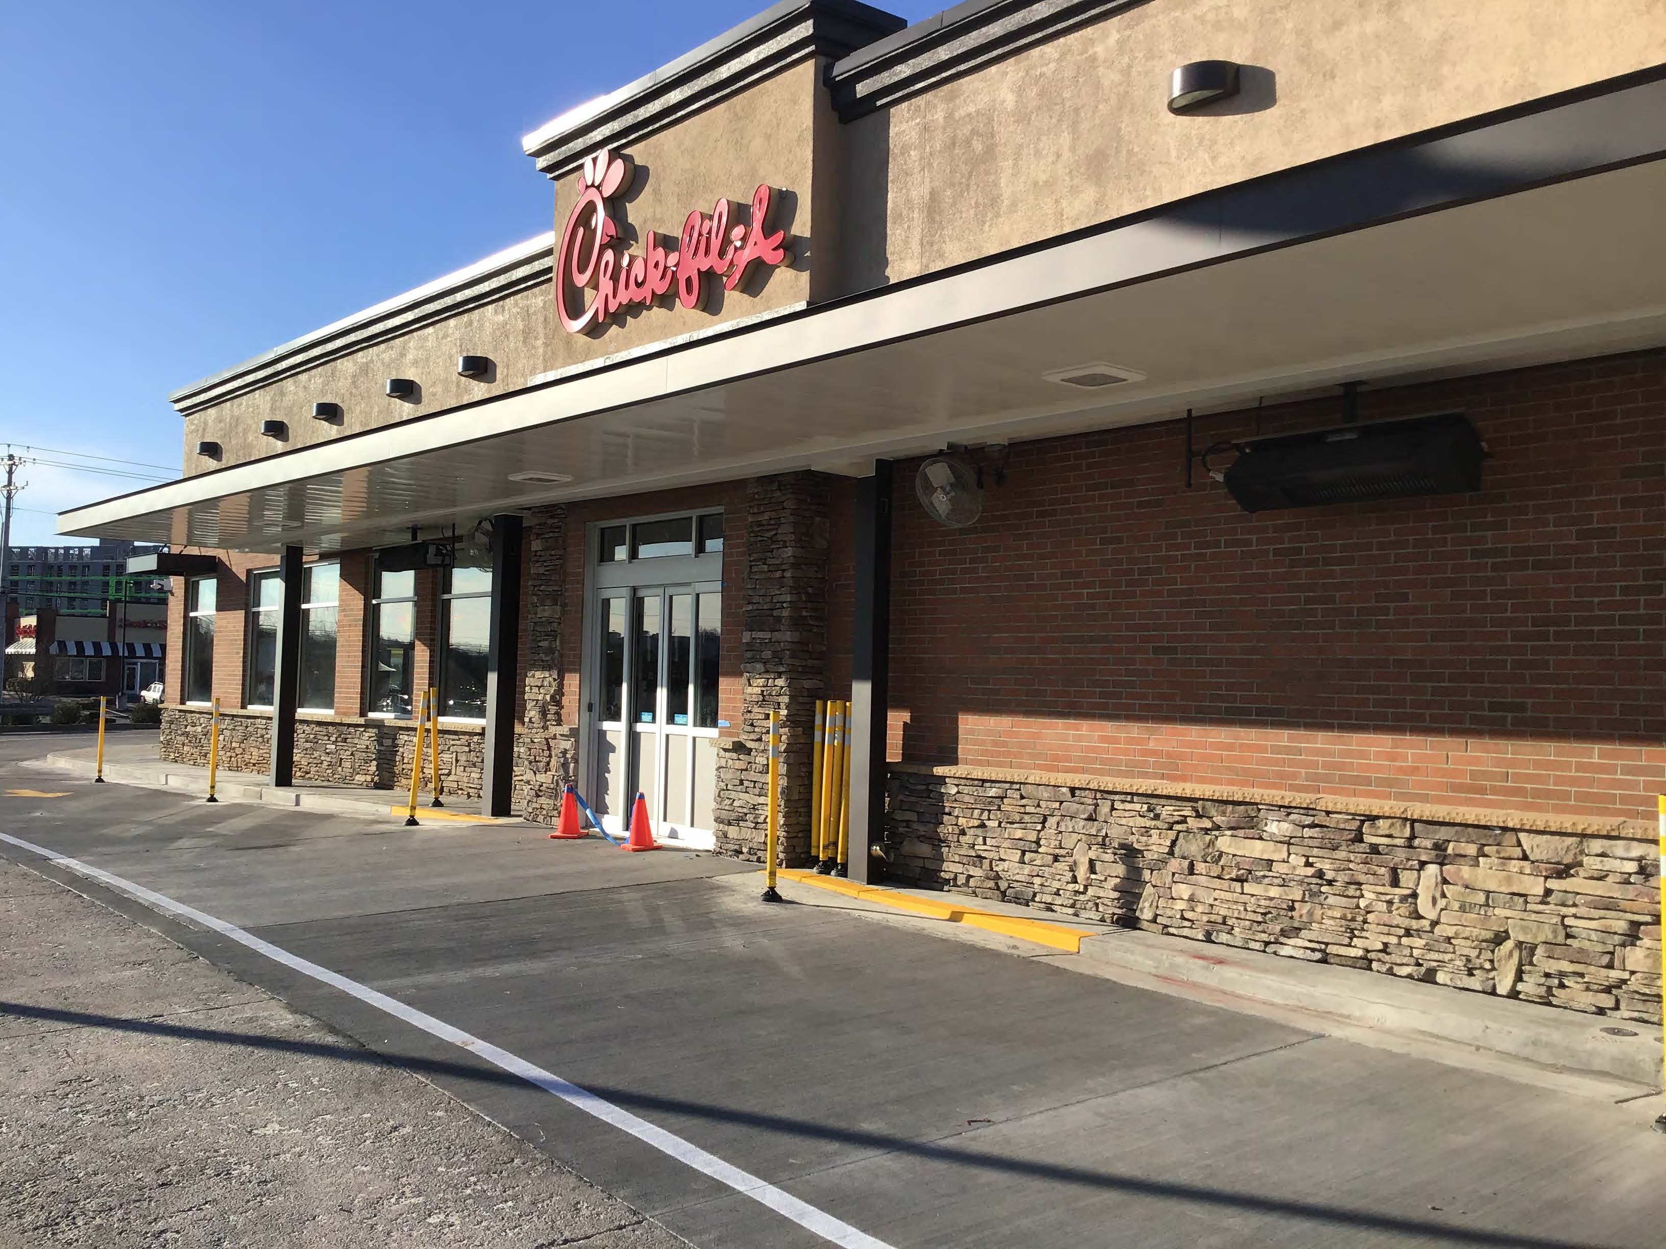

Slide 16
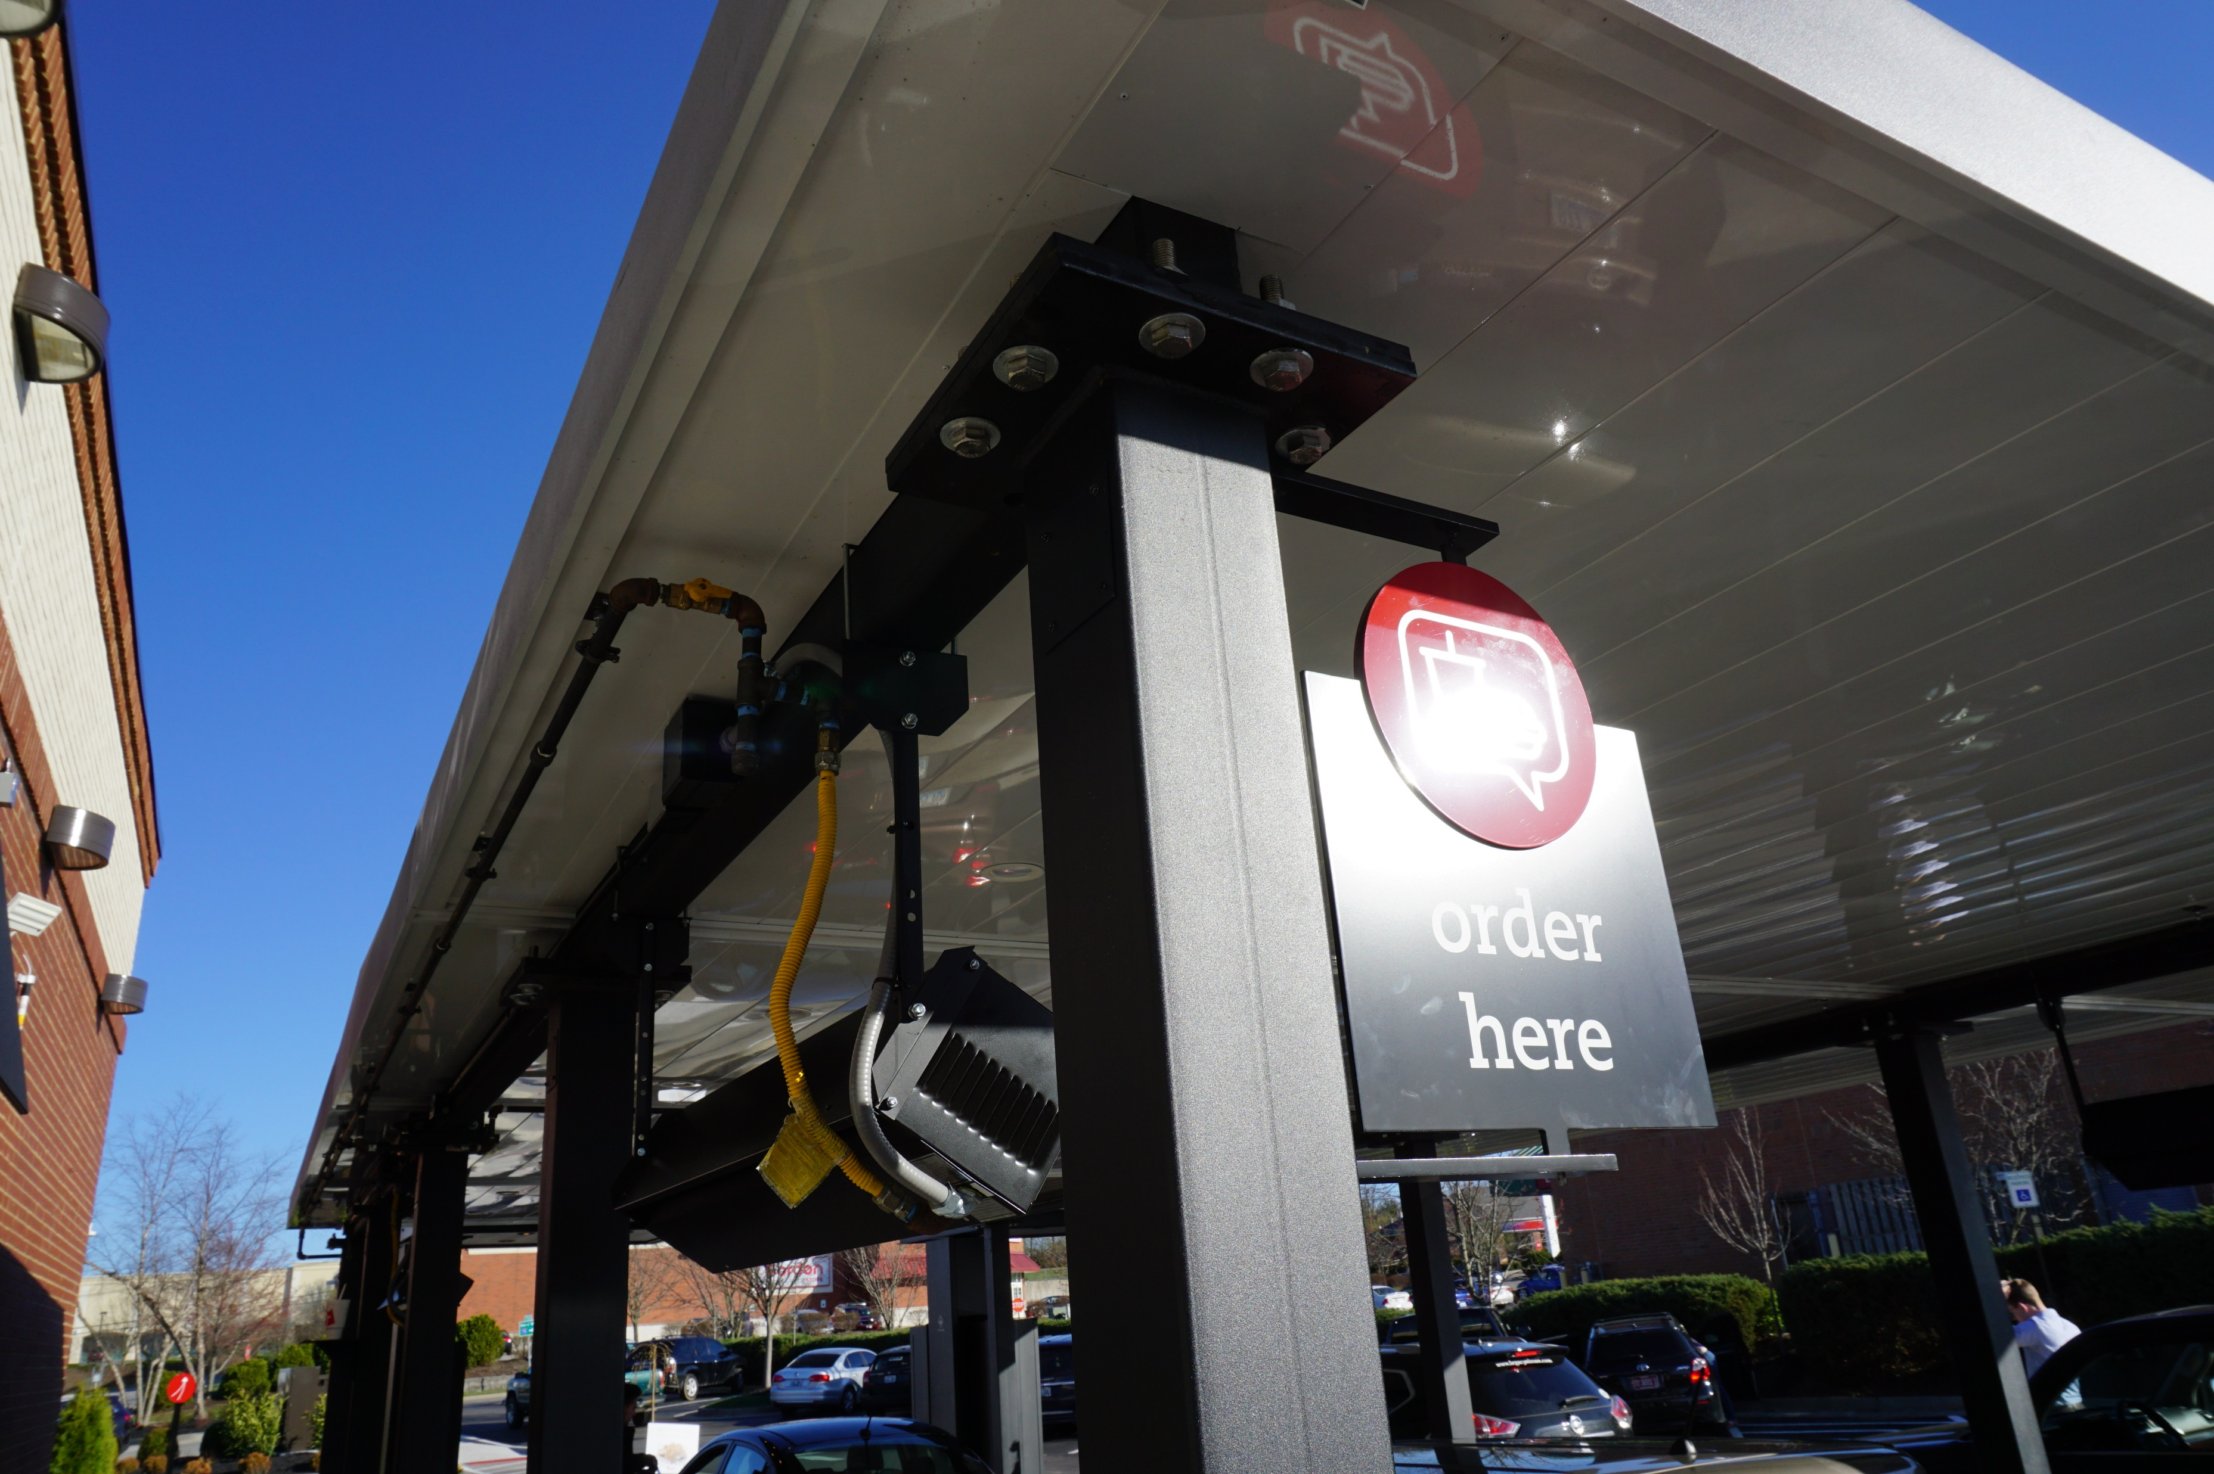
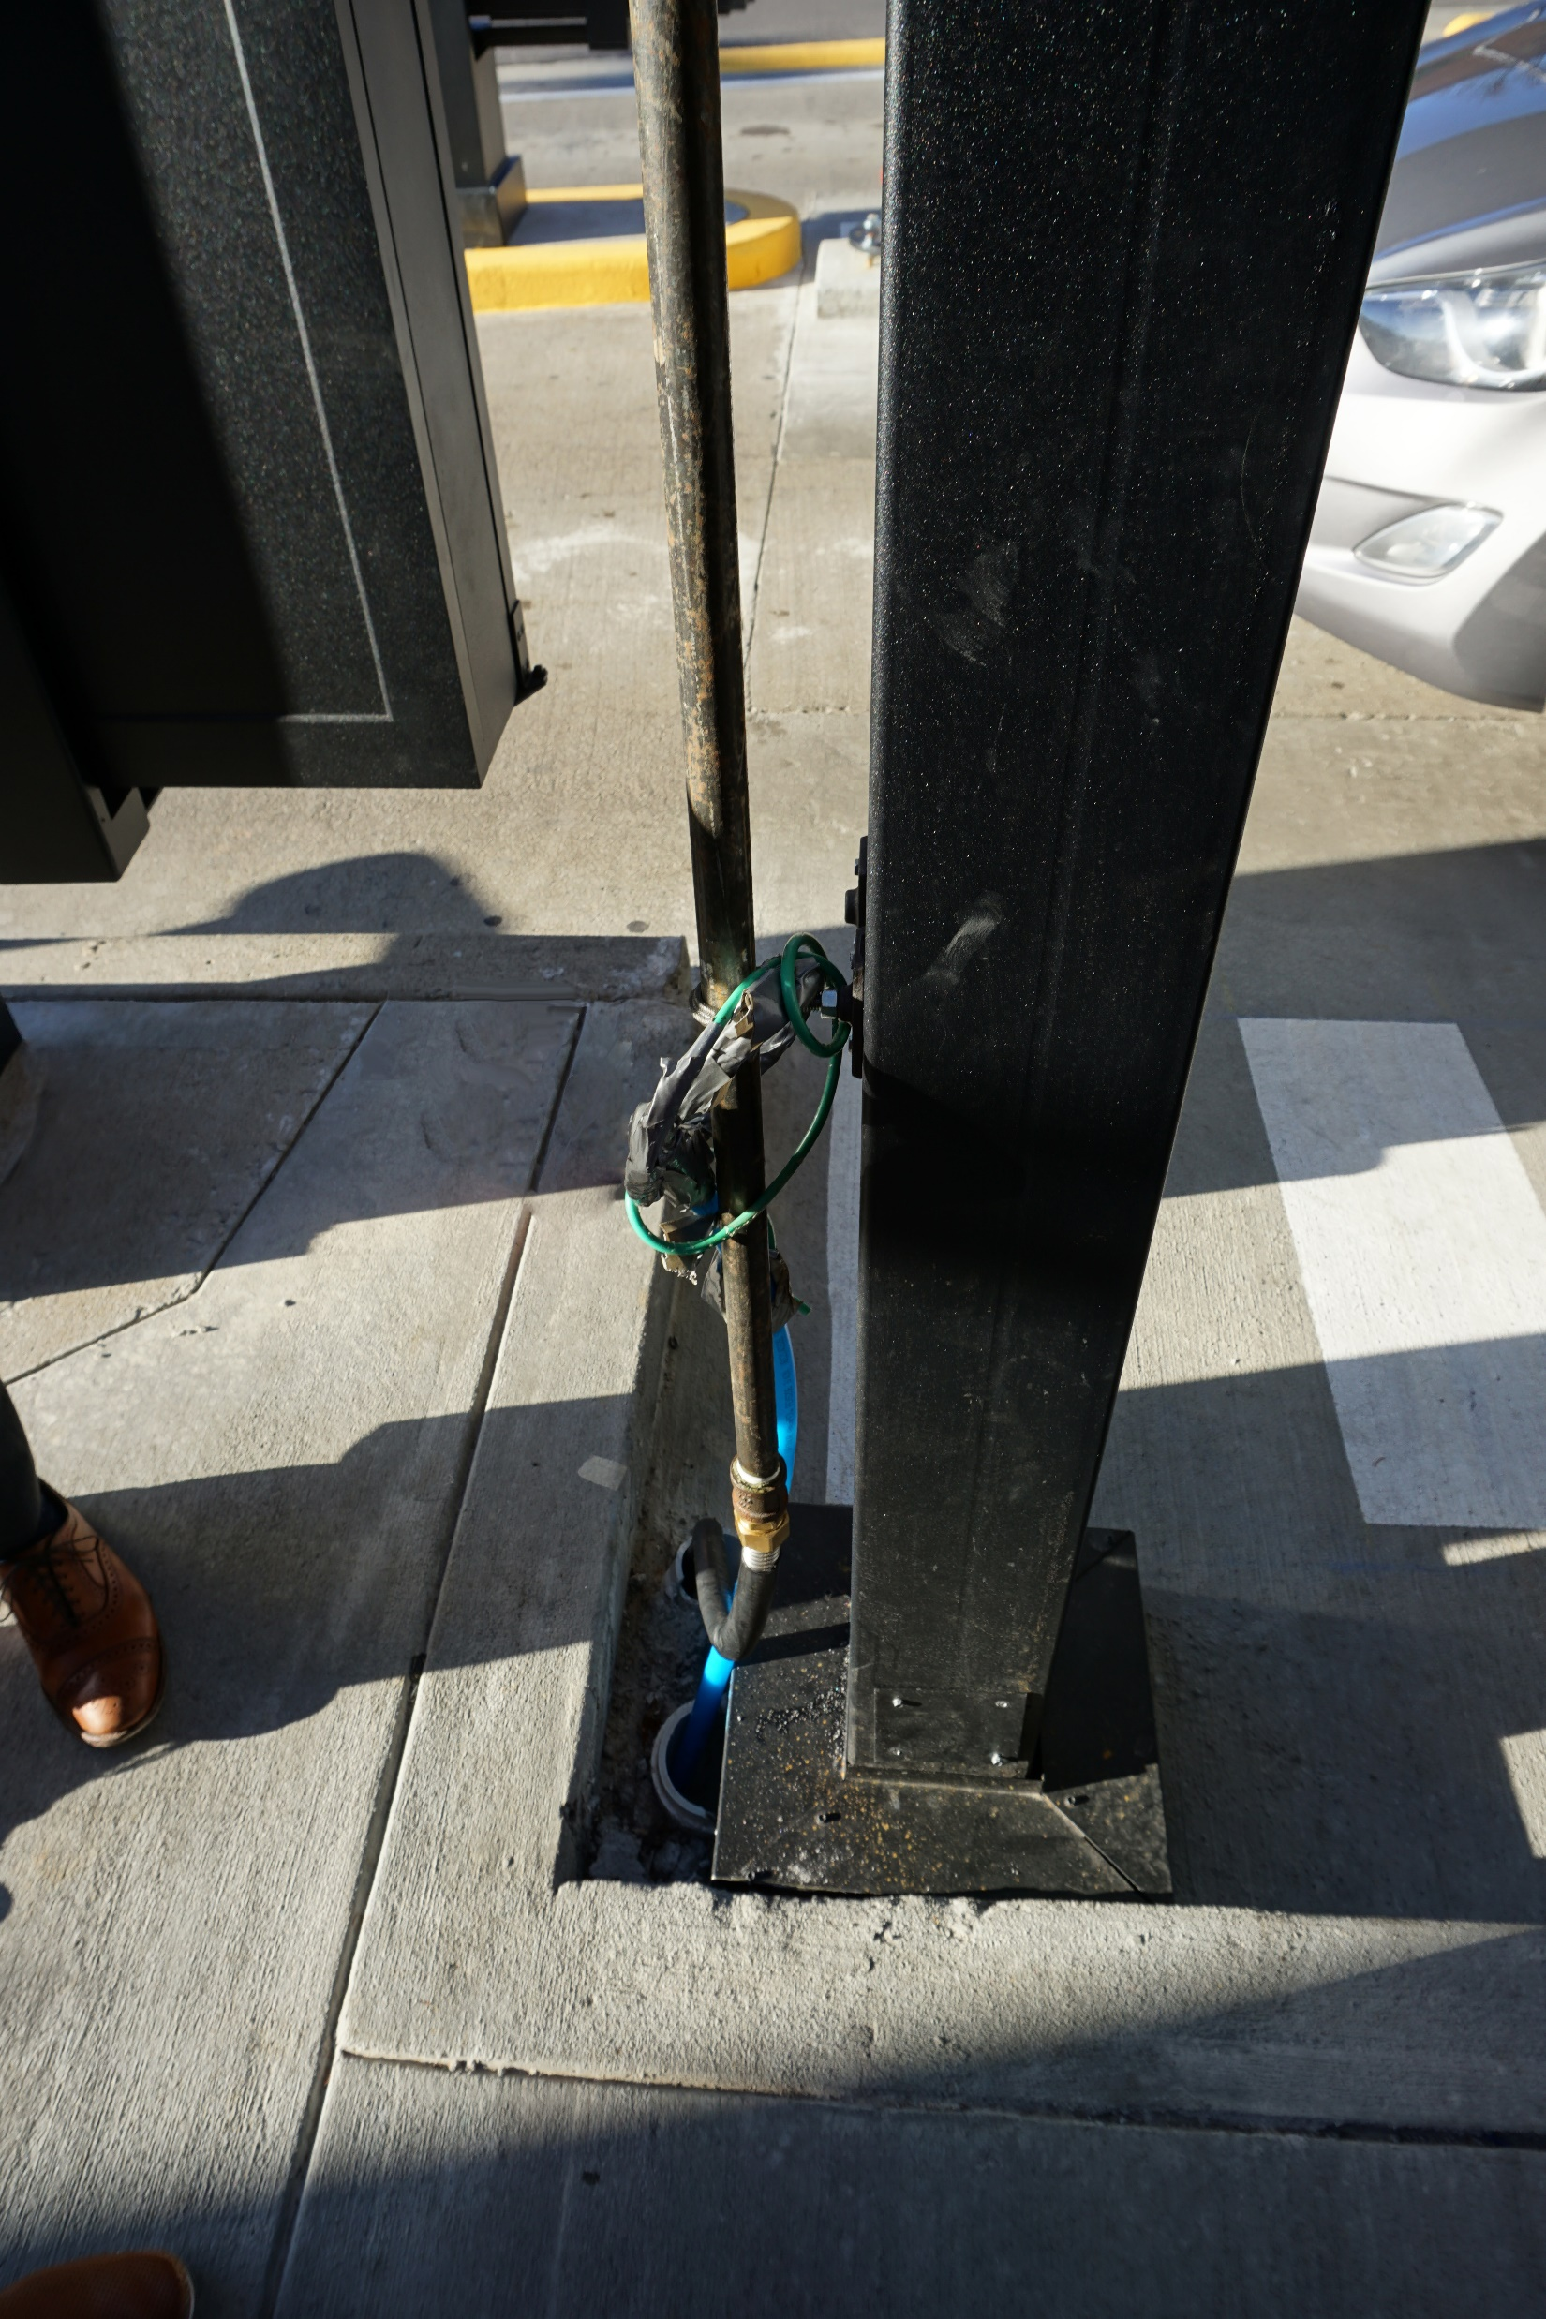
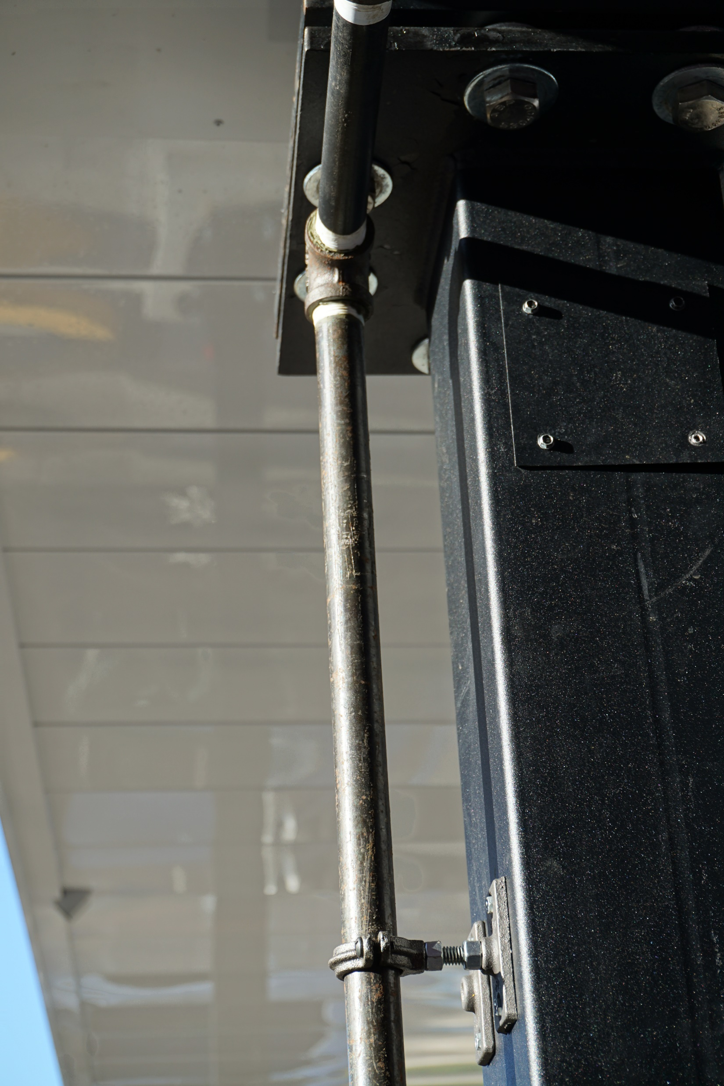

Slide 17
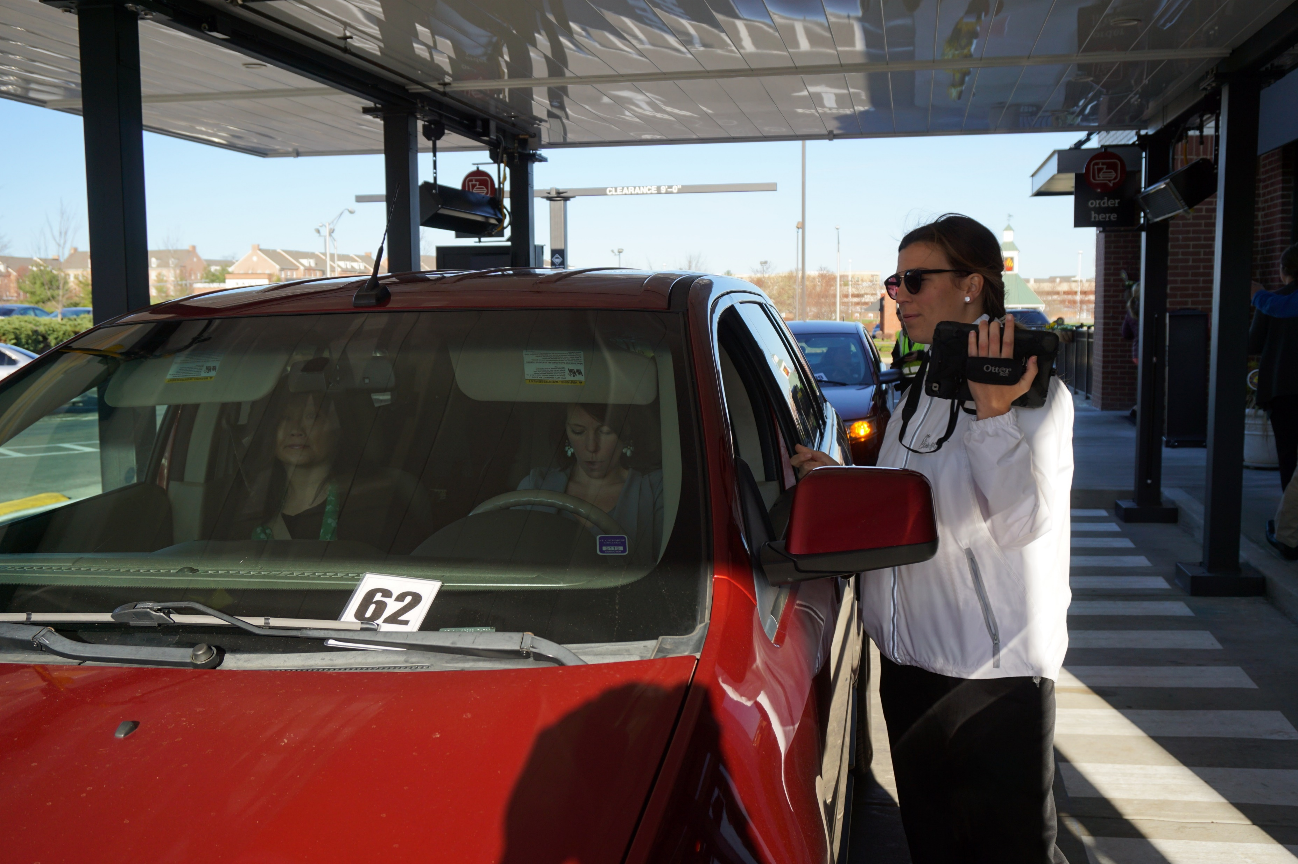
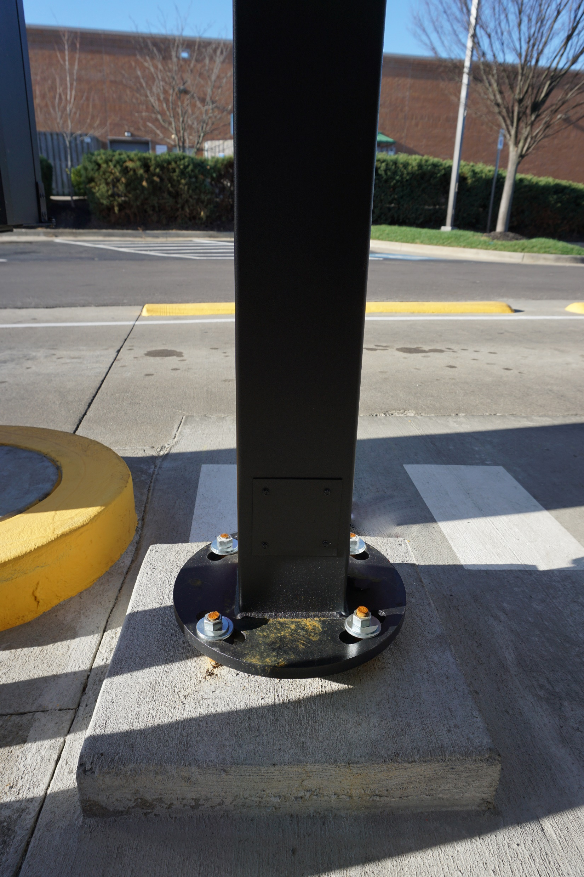
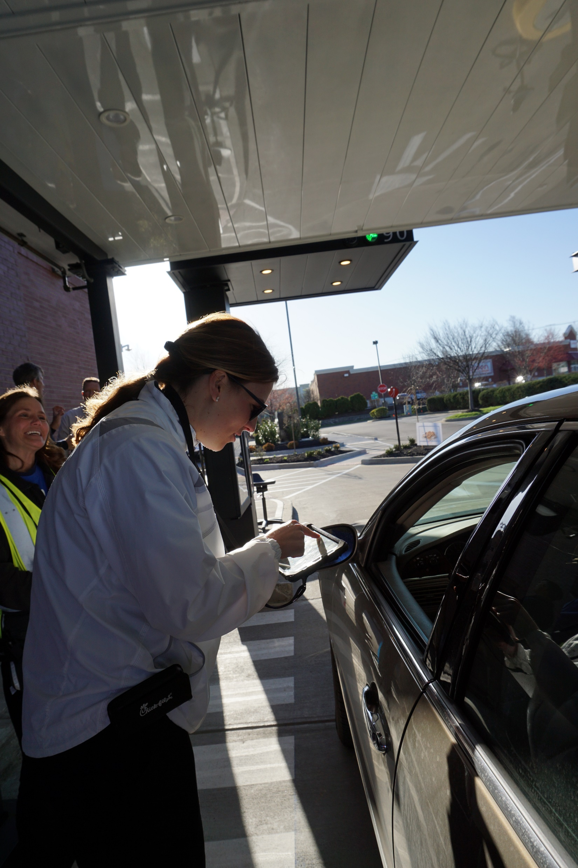

Slide 18
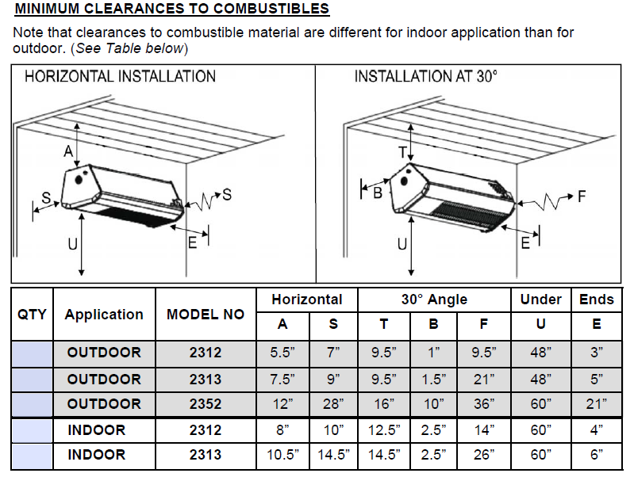
Canopy Heaters

Slide 19
Canopy Heaters

Slide 20
Canopy Fans

Slide 21
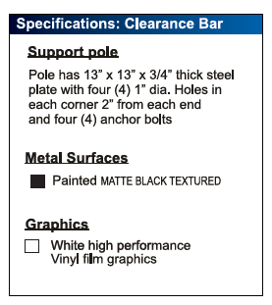
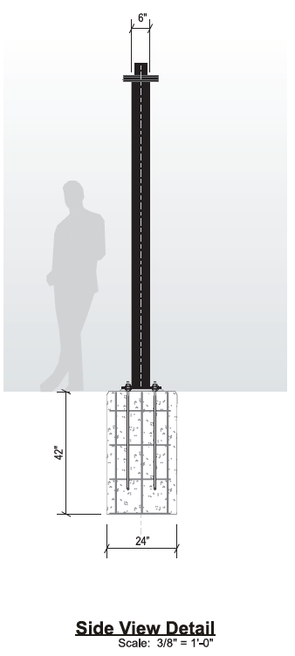
Clearance Bars

Slide 22
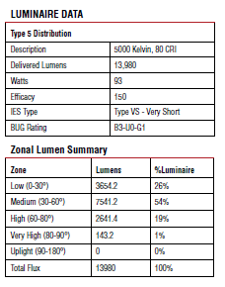
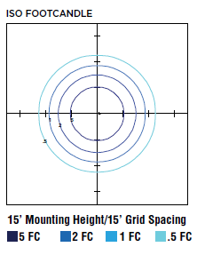
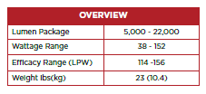
LED Lighting

Slide 23
LED Lights vs. CFL Lights
Lower Energy Consumption – LEDs consume 80-90% less energy than incandescent lights.
Longer Life – The life of a quality LED Bulb is estimated to be at least 25,000 hours – that’s over 11 years (based on an average of 6 hours a day). CFL lights are only estimated to have a life span of 10,000 hours or about 4 ½ years.
Durable – LEDs have no filaments, so they can withstand heavy vibrations. They also resist shock and external impacts which make them great for outdoor lighting systems.

Slide 24
Overall Site Plan in Relation to Building

Slide 25
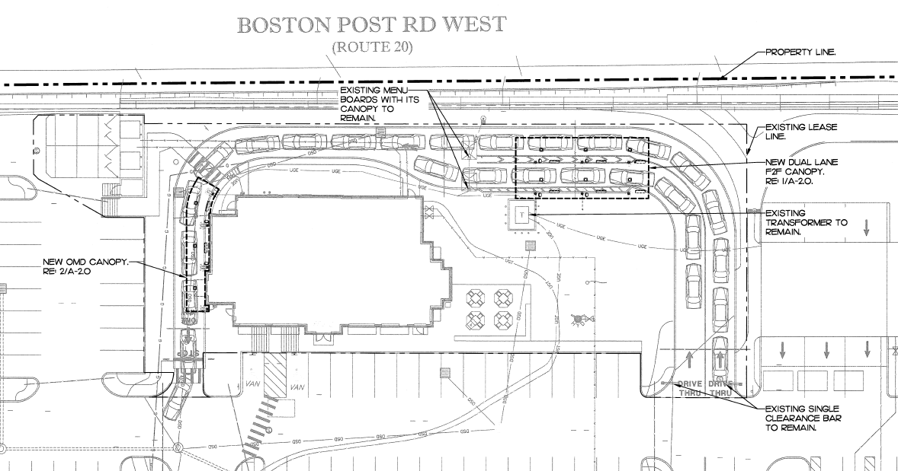

Slide 26
Canopy Plans – Face to Face (F2F) Canopy

Slide 27
F2F Canopy

Slide 28
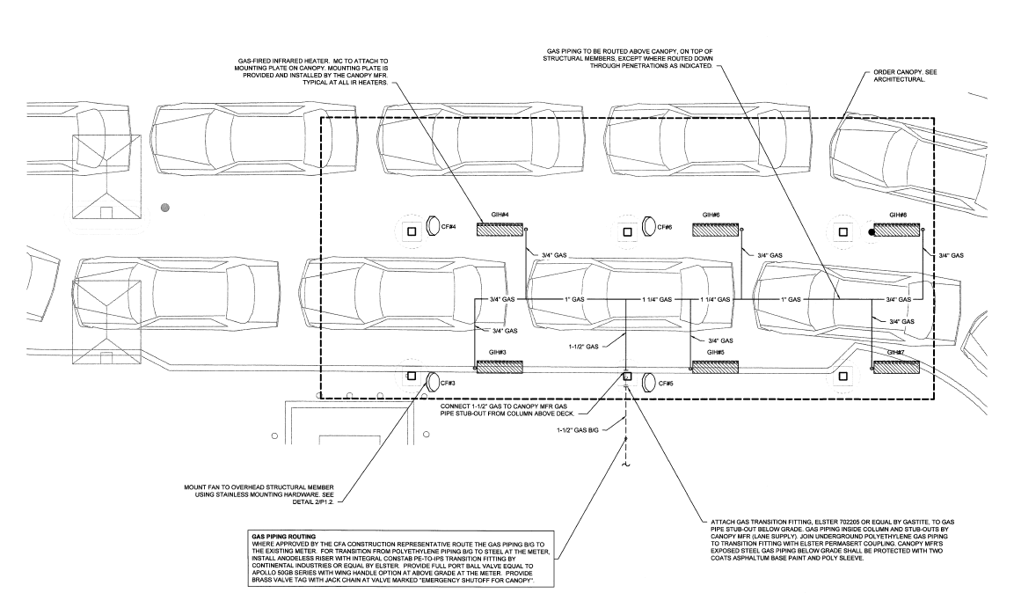
F2F Canopy – Gas Plan

Slide 29
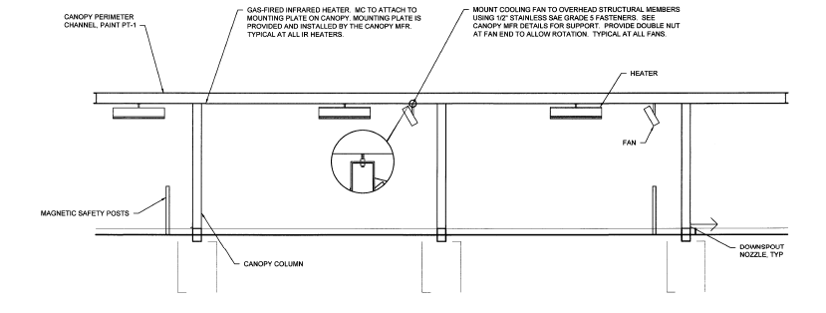
F2F Canopy – Heater Fan Section

Slide 30
Canopy Plans – Order Meal Delivery (OMD) Canopy

Slide 31
OMD Canopy

Slide 32
OMD Canopy – Gas Plan

Slide 33
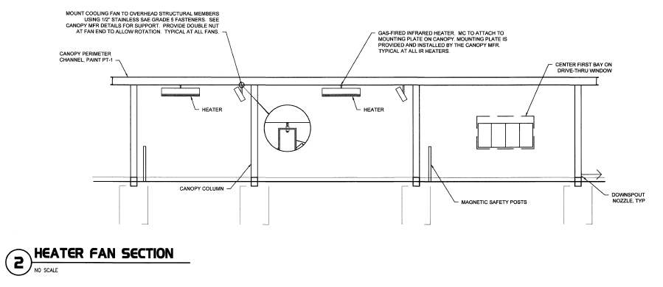
OMD Canopy – Heater Fan Section

Slide 34
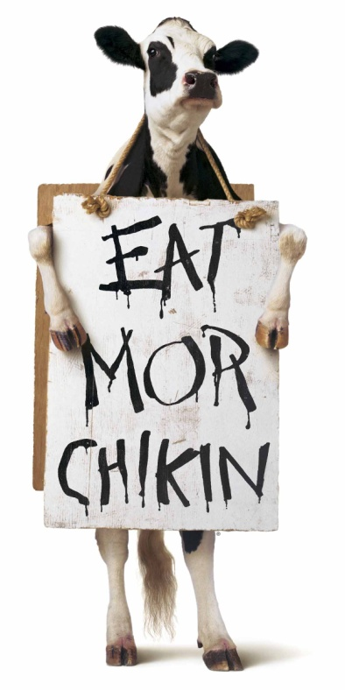
Chick-fil-A Representatives Are Available to Answer any Questions You May Have

